Slide 1

COMP9313: Big Data Management
Lecturer: Xin Cao
Course web site: http://www.cse.unsw.edu.au/~cs9313/

Slide 2
Chapter 5: Graph Data Processing
in MapReduce

Slide 3
What’s a Graph?
G = (V,E), where
  V represents the set of vertices (nodes)
  E represents the set of edges (links)
  Both vertices and edges may contain additional information
Different types of graphs:
  Directed vs. undirected edges
  Presence or absence of cycles
Graphs are everywhere:
  Hyperlink structure of the Web
  Physical structure of computers on the Internet
  Interstate highway system
  Social networks

Slide 4

Graph Data: Social Networks
Facebook social graph
4-degrees of separation [Backstrom-Boldi-Rosa-Ugander-Vigna, 2011]

Slide 5
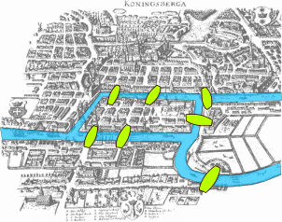
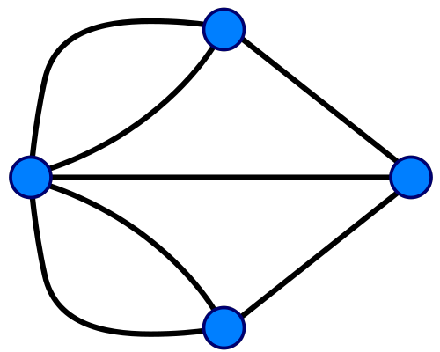
Graph Data: Technological Networks
Seven Bridges of Königsberg
[Euler, 1735]
Return to the starting point by traveling each link of the graph once and only once.

Slide 6
Some Graph Problems
Finding shortest paths
  Routing Internet traffic and UPS trucks
Finding minimum spanning trees
  Telco laying down fiber
Finding Max Flow
  Airline scheduling
Identify “special” nodes and communities
  Breaking up terrorist cells, spread of avian flu
Bipartite matching
  Monster.com, Match.com
And of course... PageRank

Slide 7
Graph Analytics
General Graph
  Count the number of nodes whose degree is equal to 5
  Find the diameter of the graphs
Web Graph
  Rank each webpage in the web graph or each user in the twitter graph using PageRank, or other centrality measure
Transportation Network
  Return the shortest or cheapest flight/road from one city to another
Social Network
  Detect a group of users who have similar interests
Financial Network
  Find the path connecting two suspicious transactions;
… …

Slide 8
Graphs and MapReduce
Graph algorithms typically involve:
  Performing computations at each node: based on node features, edge features, and local link structure
  Propagating computations: “traversing” the graph
Key questions:
  How do you represent graph data in MapReduce?
  How do you traverse a graph in MapReduce?

Slide 9
Representing Graphs
Adjacency Matrices: Represent a graph as an n x n square matrix M
  n = |V|
  M_{ij} = 1 means a link from node i to j
2
 | 1 | 2 | 3 | 4
1 | 0 | 1 | 0 | 1
2 | 1 | 0 | 1 | 1
3 | 1 | 0 | 0 | 0
4 | 1 | 0 | 1 | 0
1
3
4

Slide 10
Adjacency Matrices: Critique
Advantages:
  Amenable to mathematical manipulation
  Iteration over rows and columns corresponds to computations on outlinks and inlinks
Disadvantages:
  Lots of zeros for sparse matrices
  Lots of wasted space

Slide 11
Representing Graphs
Adjacency Lists: Take adjacency matrices… and throw away all the zeros
 | 1 | 2 | 3 | 4
1 | 0 | 1 | 0 | 1
2 | 1 | 0 | 1 | 1
3 | 1 | 0 | 0 | 0
4 | 1 | 0 | 1 | 0
1: 2, 4
2: 1, 3, 4
3: 1
4: 1, 3

Slide 12
Adjacency Lists: Critique
Advantages:
  Much more compact representation
  Easy to compute over outlinks
Disadvantages:
  Much more difficult to compute over inlinks

Slide 13
Problem 1: Single-Source Shortest Path

Slide 14
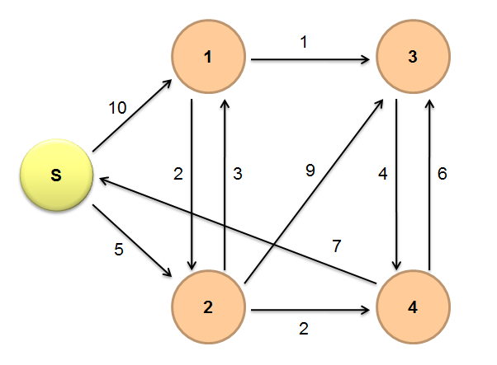
Single-Source Shortest Path (SSSP)
Problem: find shortest path from a source node to one or more target nodes
  Shortest might also mean lowest weight or cost
Dijkstra’s Algorithm:
  For a given source node in the graph, the algorithm finds the shortest path between that node and every other

Slide 15
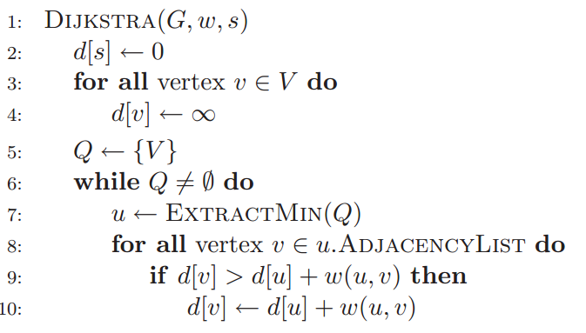
Dijkstra’s Algorithm

Slide 16
Dijkstra’s Algorithm Example
∞
1
∞
10
0
2
3
9
4
6
5
7
∞
∞
2
Example from CLR

Slide 17
Dijkstra’s Algorithm Example
10
1
∞
10
0
2
3
9
4
6
5
7
5
∞
2
Example from CLR

Slide 18
Dijkstra’s Algorithm Example
8
1
14
10
0
2
3
9
4
6
5
7
5
7
2
Example from CLR

Slide 19
Dijkstra’s Algorithm Example
8
1
13
10
0
2
3
9
4
6
5
7
5
7
2
Example from CLR

Slide 20
Dijkstra’s Algorithm Example
8
1
9
10
0
2
3
9
4
6
5
7
5
7
2
Example from CLR

Slide 21
Dijkstra’s Algorithm Example
8
1
9
10
0
2
3
9
4
6
5
7
5
7
2
Finish!
Example from CLR

Slide 22
Single Source Shortest Path
Problem: find shortest path from a source node to one or more target nodes
  Shortest might also mean lowest weight or cost
Single processor machine: Dijkstra’s Algorithm
MapReduce: parallel Breadth-First Search (BFS)

Slide 23
Finding the Shortest Path
Consider simple case of equal edge weights
Solution to the problem can be defined inductively
Here’s the intuition:
  Define: b is reachable from a if b is on adjacency list of a
  DistanceTo(s) = 0
  For all nodes p reachable from s,
  DistanceTo(p) = 1
  For all nodes n reachable from some other set of nodes M, DistanceTo(n) = 1 + min(DistanceTo(m), m ∈ M)
d₁
m₁
…
d₂
s
…
n
m₂
…
d₃
m₃

Slide 24
Visualizing Parallel BFS
n₇
n₀
n₁
n₃
n₂
n₆
n₅
n₄
n₈
n₉

Slide 25
From Intuition to Algorithm
Data representation:
  Key: node n
  Value: d (distance from start), adjacency list (list of nodes reachable from n)
  Initialization: for all nodes except for start node, d = ∞
Mapper:
  ∀m ∈ adjacency list: emit (m, d + 1)
Sort/Shuffle
  Groups distances by reachable nodes
Reducer:
  Selects minimum distance path for each reachable node
  Additional bookkeeping needed to keep track of actual path

Slide 26
Multiple Iterations Needed
Each MapReduce iteration advances the “known frontier” by one hop
  Subsequent iterations include more and more reachable nodes as frontier expands
  The input of Mapper is the output of Reducer in the previous iteration
  Multiple iterations are needed to explore entire graph
Preserving graph structure:
  Problem: Where did the adjacency list go?
  Solution: mapper emits (n, adjacency list) as well

Slide 27
BFS Pseudo-Code
Equal Edge Weights (how to deal with weighted edges?)
Only distances, no paths stored (how to obtain paths?)
class Mapper
method Map(nid n, node N)
d ← N.Distance
Emit(nid n,N) //Pass along graph structure
for all nodeid m ∈ N.AdjacencyList do
Emit(nid m, d+1) //Emit distances to reachable nodes
class Reducer
method Reduce(nid m, [d1, d2, . . .])
d_{min}←∞
M ← ∅
for all d ∈ counts [d1, d2, . . .] do
if IsNode(d) then
M ← d //Recover graph structure
else if d < d_{min} then //Look for shorter distance
d_{min} ← d
M.Distance ← d_{min} //Update shortest distance
Emit(nid m, node M)

Slide 28
Stopping Criterion
How many iterations are needed in parallel BFS (equal edge weight case)?
Convince yourself: when a node is first “discovered”, we’ve found the shortest path
Now answer the question...
  The diameter of the graph, or the greatest distance between any pair of nodes
  Six degrees of separation?
    If this is indeed true, then parallel breadth-first search on the global social network would take at most six MapReduce iterations.

Slide 29
Implementation in MapReduce
The actual checking of the termination condition must occur outside of MapReduce.
The driver (main) checks to see if a termination condition has been met, and if not, repeats.
Hadoop provides a lightweight API called “counters”.
  It can be used for counting events that occur during execution, e.g., number of corrupt records, number of times a certain condition is met, or anything that the programmer desires.
  Counters can be designed to count the number of nodes that have distances of ∞ at the end of the job, the driver program can access the final counter value and check to see if another iteration is necessary.

Slide 30
How to Find the Shortest Path?
The parallel breadth-first search algorithm only finds the shortest distances.
Store “back-pointers” at each node, as with Dijkstra's algorithm
  Not efficient to recover the path from the back-pointers
A simpler approach is to emit paths along with distances in the mapper, so that each node will have its shortest path easily accessible at all times
  The additional space requirement is acceptable

Slide 31
Mapper
public static class TheMapper extends Mapper<LongWritable, Text, LongWritable, Text> {
public void map(LongWritable key, Text value, Context context) throws IOException, InterruptedException {
Text word = new Text();
String line = value.toString();//looks like 1 0 2:3:
String[] sp = line.split(" ");//splits on space
int distanceadd = Integer.parseInt(sp[1]) + 1;
String[] PointsTo = sp[2].split(":");
for(int i=0; i<PointsTo.length; i++){
word.set("VALUE "+distanceadd);//tells me to look at distance value
context.write(new LongWritable(Integer.parseInt(PointsTo[i])), word);
word.clear(); }
//pass in current node's distance (if it is the lowest distance)
word.set("VALUE "+sp[1]);
context.write( new LongWritable( Integer.parseInt( sp[0] ) ), word );
word.clear();
word.set("NODES "+sp[2]);//tells me to append on the final tally
context.write( new LongWritable( Integer.parseInt( sp[0] ) ), word );
word.clear();
}
}

Slide 32
Reducer
public static class TheReducer extends Reducer<LongWritable, Text, LongWritable, Text> {
public void reduce(LongWritable key, Iterable<Text> values, Context context) throws IOException, InterruptedException {
String nodes = "UNMODED";
Text word = new Text();
int lowest = INFINITY;//start at infinity
for (Text val : values) {
//looks like NODES/VALUES 1 0 2:3:, we need to use the first as a key
String[] sp = val.toString().split(" ");//splits on space
//look at first value
if(sp[0].equalsIgnoreCase("NODES")){
nodes = null;
nodes = sp[1];
}else if(sp[0].equalsIgnoreCase("VALUE")){
int distance = Integer.parseInt(sp[1]);
lowest = Math.min(distance, lowest);
}
}
word.set(lowest+" "+nodes);
context.write(key, word);
word.clear();
}
}
https://github.com/himank/Graph-Algorithm-MapReduce/blob/master/src/DijikstraAlgo.java

Slide 33
BFS Pseudo-Code (Weighted Edges)
The adjacency lists, which were previously lists of node ids, must now encode the edge distances as well
  Positive weights!
In line 6 of the mapper code, instead of emitting d + 1 as the value, we must now emit d + w, where w is the edge distance
The termination behaviour is very different!
  How many iterations are needed in parallel BFS (positive edge weight case)?
  Convince yourself: when a node is first “discovered”, we’ve found the shortest path
Not true!

Slide 34
Additional Complexities
Assume that p is the current processed node
  In the current iteration, we just “discovered” node r for the very first time.
  We've already discovered the shortest distance to node p, and that the shortest distance to r so far goes through p
  Is s->p->r the shortest path from s to r?
The shortest path from source s to node r may go outside the current search frontier
  It is possible that p->q->r is shorter than p->r!
  We will not find the shortest distance to r until the search frontier expands to cover q.
search frontier
r
s
p
q

Slide 35
How Many Iterations Are Needed?
In the worst case, we might need as many iterations as there are nodes in the graph minus one
  A sample graph that elicits worst-case behaviour for parallel breadth-first search.
  Eight iterations are required to discover shortest distances to all nodes from n₁.
1
n₆
1
n₇
1
n₈
10
1
n₅
n₉
n₁
1
1
1
n₄
n₂
1
n₃

Slide 36
Example (only distances)
Input file:
s --> 0 | n1: 10, n2: 5
n1 --> ∞ | n2: 2, n3:1
n2 --> ∞ | n1: 3, n3:9， n4:2
n3 --> ∞ | n4:4
n4 --> ∞ | s:7, n3:6

Slide 37
Iteration 1
Map:
Read s --> 0 | n1: 10, n2: 5
Emit: (n1, 10), (n2, 5), and the adjacency list (s, n1: 10, n2: 5)
The other lists will also be read and emit, but they do not contribute, and thus ignored
Reduce:
Receives: (n1, 10), (n2, 5), (s, <0, (n1: 10, n2: 5)>)
The adjacency list of each node will also be received, ignored in example
Emit:
s --> 0 | n1: 10, n2: 5
n1 --> 10 | n2: 2, n3:1
n2 --> 5 | n1: 3, n3:9， n4:2

Slide 38
Iteration 2
Map:
Read: n1 --> 10 | n2: 2, n3:1
Emit: (n2, 12), (n3, 11), (n1, <10, (n2: 2, n3:1)>)
Read: n2 --> 5 | n1: 3, n3:9， n4:2
Emit: (n1, 8), (n3, 14), (n4, 7)，(n2, <5, (n1: 3, n3:9，n4:2)>)
Ignore the processing of the other lists
Reduce:
Receives: (n1, (8, <10, (n2: 2, n3:1)>)), (n2, (12, <5, n1: 3, n3:9，n4:2>)), (n3, (11, 14)), (n4, 7)
Emit:
n1 --> 8 | n2: 2, n3:1
n2 --> 5 | n1: 3, n3:9， n4:2
n3 --> 11 | n4:4
n4 --> 7 | s:7, n3:6

Slide 39
Iteration 3
Map:
Read: n1 --> 8 | n2: 2, n3:1
Emit: (n2, 10), (n3, 9), (n1, <8, (n2: 2, n3:1)>)
Read: n2 --> 5 | n1: 3, n3:9， n4:2 (Again!)
Emit: (n1, 8), (n3, 14), (n4, 7)，(n2, <5, (n1: 3, n3:9，n4:2)>)
Read: n3 --> 11 | n4:4
Emit: (n4, 15)，(n3, <11, (n4:4)>)
Read: n4 --> 7 | s:7, n3:6
Emit: (s, 14), (n3, 13), (n4, <7, (s:7, n3:6)>)
Reduce:
Emit:
n1 --> 8 | n2: 2, n3:1
n2 --> 5 | n1: 3, n3:9， n4:2
n3 --> 9 | n4:4
n4 --> 7 | s:7, n3:6

Slide 40
Iteration 4
In order to avoid duplicated computations, you can use a status value to indicate whether the distance of the node has been modified in the previous iteration.
Map:
Read: n1 --> 8 | n2: 2, n3:1 (Again!)
Emit: (n2, 10), (n3, 9), (n1, <8, (n2: 2, n3:1)>)
Read: n2 --> 5 | n1: 3, n3:9， n4:2 (Again!)
Emit: (n1, 8), (n3, 14), (n4, 7)，(n2, <5, (n1: 3, n3:9，n4:2)>)
Read: n3 --> 9 | n4:4
Emit: (n4, 13)，(n3, <9, (n4:4)>)
Read: n4 --> 7 | s:7, n3:6 (Again!)
Emit: (s, 14), (n3, 13), (n4, <7, (s:7, n3:6)>)
Reduce:
Emit:
n1 --> 8 | n2: 2, n3:1
n2 --> 5 | n1: 3, n3:9， n4:2
n3 --> 9 | n4:4
n4 --> 7 | s:7, n3:6
No updates. Terminate.

Slide 41
Comparison to Dijkstra
Dijkstra’s algorithm is more efficient
  At any step it only pursues edges from the minimum-cost path inside the frontier
MapReduce explores all paths in parallel
  Lots of “waste”
  Useful work is only done at the “frontier”
Why can’t we do better using MapReduce?

Slide 42
Problem 2: PageRank

Slide 43
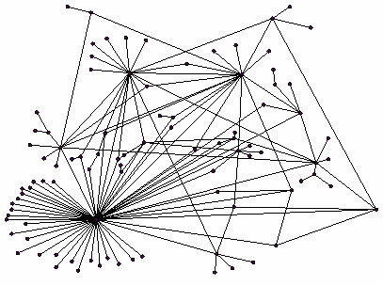
Ranking Nodes on the Graph
All web pages are not equally “important”
  http://xxx.github.io/ vs. http://www.unsw.edu.au/
There is large diversity in the web-graph node connectivity. Let’s rank the pages by the link structure!

Slide 44
Links as Votes
Idea: Links as votes
  Page is more important if it has more links
  In-coming links? Out-going links?
Think of in-links as votes:
  http://www.unsw.edu.au/ has 23,400 in-links
  http://xxx.github.io/ has 1 in-link
Are all in-links equal?
  Links from important pages count more
  Recursive question!

Slide 45
Example: PageRank Scores
B
38.4
C
34.3
A
3.3
D
3.9
E
8.1
F
3.9
1.6
1.6
1.6
1.6
1.6

Slide 46
Simple Recursive Formulation
Each link’s vote is proportional to the importance of its source page
If page j with importance r_{j} has n out-links, each link gets r_{j} / n votes
Page j’s own importance is the sum of the votes on its in-links
i
k
r_{i}/3
r_{k}/4
j
r_{j}/3
r_{j} = r_{i}/3+r_{k}/4
r_{j}/3
r_{j}/3

Slide 47

PageRank: The “Flow” Model
A “vote” from an important page is worth more
A page is important if it is pointed to by other important pages
Define a “rank” r_{j} for page j
y/2
y
a/2
y/2
m
a
m
a/2
“Flow” equations:
  r_{y} = r_{y} /2 + r_{a} /2
  r_{a} = r_{y} /2 + r_{m}
  r_{m} = r_{a} /2

Slide 48
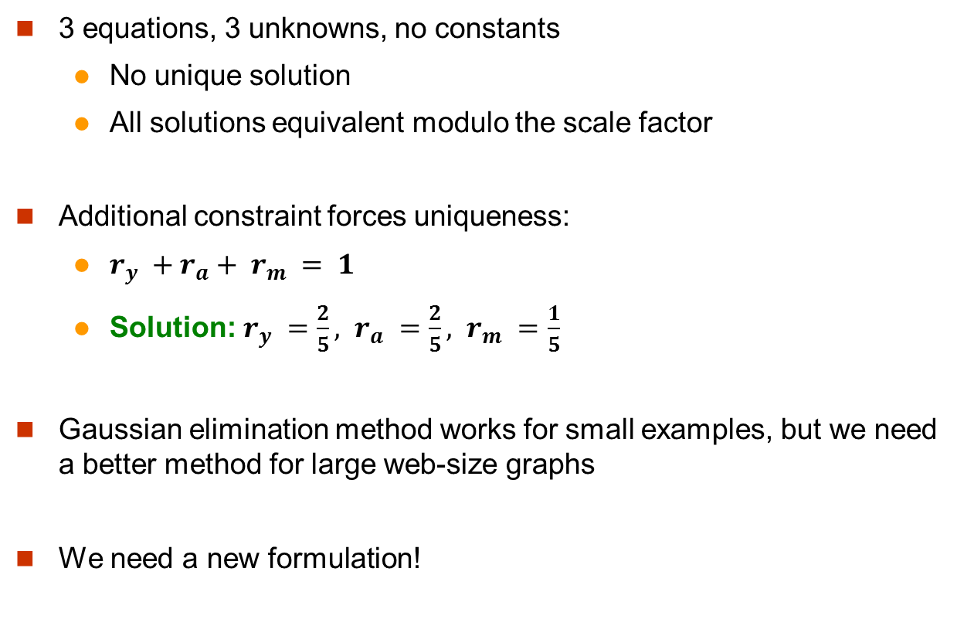
Solving the Flow Equations
Flow equations:
  r_{y} = r_{y} /2 + r_{a} /2
  r_{a} = r_{y} /2 + r_{m}
  r_{m} = r_{a} /2
3 equations, 3 unknowns, no constants
  No unique solution
  All solutions equivalent modulo the scale factor
Additional constraint forces uniqueness:
  $r_{y} +r_{a}+ r_{m} = 1$
  Solution: $r_{y} =\frac{2}{5}, r_{a} =\frac{2}{5}, r_{m} =\frac{1}{5}$
Gaussian elimination method works for small examples, but we need a better method for large web-size graphs
We need a new formulation!

Slide 49
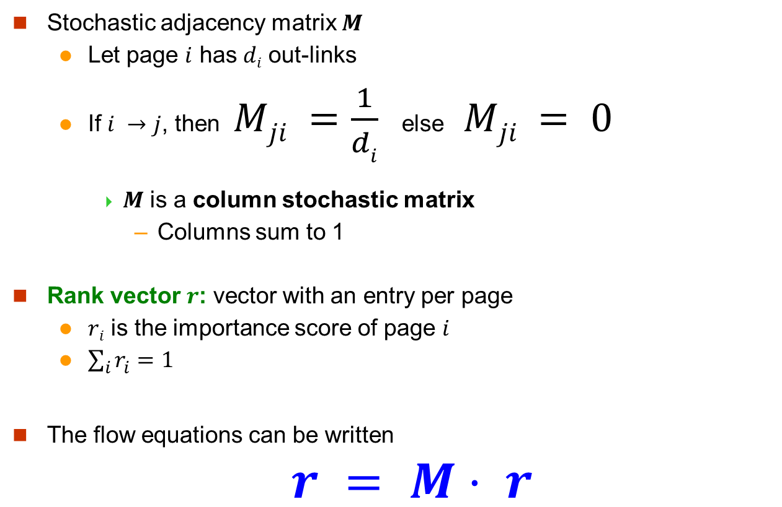
PageRank: Matrix Formulation
Stochastic adjacency matrix $M$
  Let page $i$ has $di$ out-links
  If $i →j$, then $Mji =\frac{1}{di}$ else $Mji = 0$
    $M$ is a column stochastic matrix
      Columns sum to 1
Rank vector $r$: vector with an entry per page
  $ri$ is the importance score of page $i$
  $\sum_{i}{r_{i}^{}=1}$
The flow equations can be written
$r = M⋅ r$

Slide 50

Example
Remember the flow equation:
Flow equation in the matrix form
$$M⋅ r=r$$
  Suppose page i links to 3 pages, including j
i
j
r_{j}
.
=
r_{i}
1/3
M
.
r
=
r

Slide 51

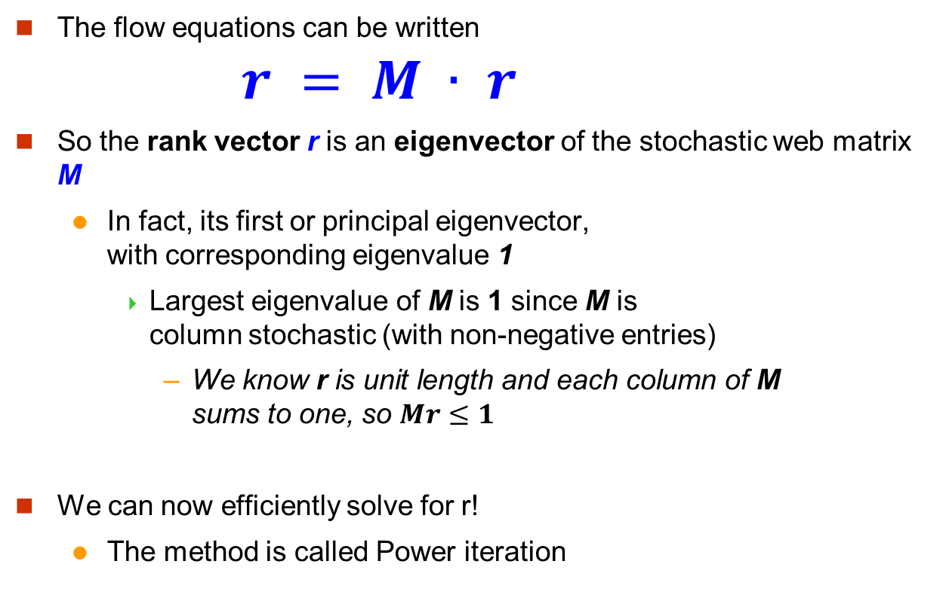
Eigenvector Formulation
The flow equations can be written
$r = M ∙ r$
So the rank vector r is an eigenvector of the stochastic web matrix M
  In fact, its first or principal eigenvector,
  with corresponding eigenvalue 1
    Largest eigenvalue of M is 1 since M is
    column stochastic (with non-negative entries)
      We know r is unit length and each column of M
      sums to one, so $Mr≤1$
We can now efficiently solve for r!
  The method is called Power iteration
NOTE: x is an eigenvector with the corresponding eigenvalue λ if:
$$Ax=λx$$

Slide 52
Example: Flow Equations & M
 | y | a | m
y | ½ | ½ | 0
a | ½ | 0 | 1
m | 0 | ½ | 0
y
a
m
r = M∙r
  r_{y} = r_{y} /2 + r_{a} /2
  r_{a} = r_{y} /2 + r_{m}
  r_{m} = r_{a} /2
y ½ ½ 0 y
a = ½ 0 1 a
m 0 ½ 0 m

Slide 53
Power Iteration Method
Given a web graph with n nodes, where the nodes are pages and edges are hyperlinks
Power iteration: a simple iterative scheme
  Suppose there are N web pages
  Initialize: r⁽⁰⁾ = [1/N,….,1/N]^{T}
  Iterate: r^{(t+1)} = M ∙ r^{(t)}
  Stop when |r^{(t+1)} – r^{(t)}|₁ < ε
d_{i} …. out-degree of node i
    |x|₁ = ∑_{1≤i≤N}|x_{i}| is the L1 norm
    Can use any other vector norm, e.g., Euclidean

Slide 54
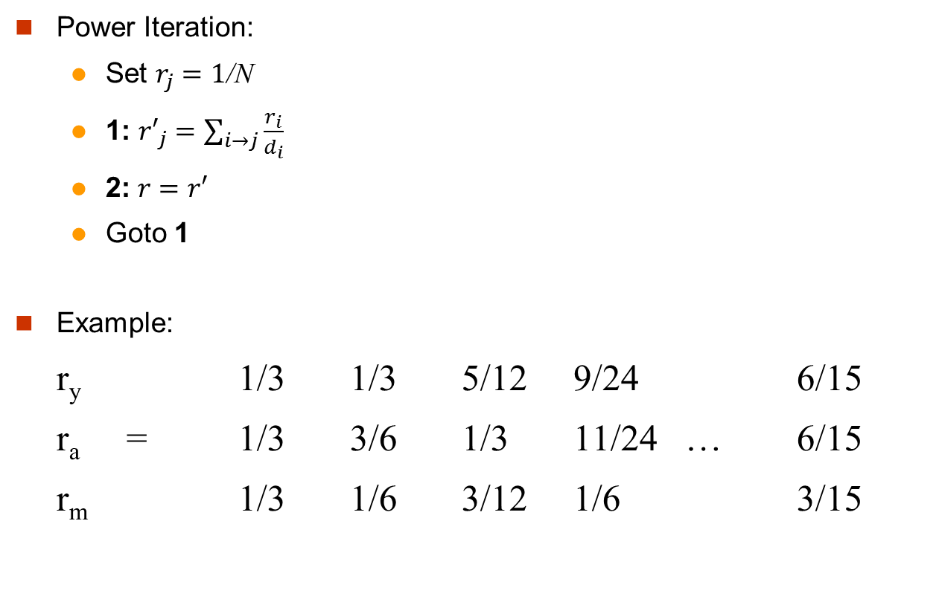
PageRank: How to solve?
y
 | y | a | m
y | ½ | ½ | 0
a | ½ | 0 | 1
m | 0 | ½ | 0
a
m
  r_{y} = r_{y} /2 + r_{a} /2
  r_{a} = r_{y} /2 + r_{m}
  r_{m} = r_{a} /2
Iteration 0, 1, 2, …

Slide 55
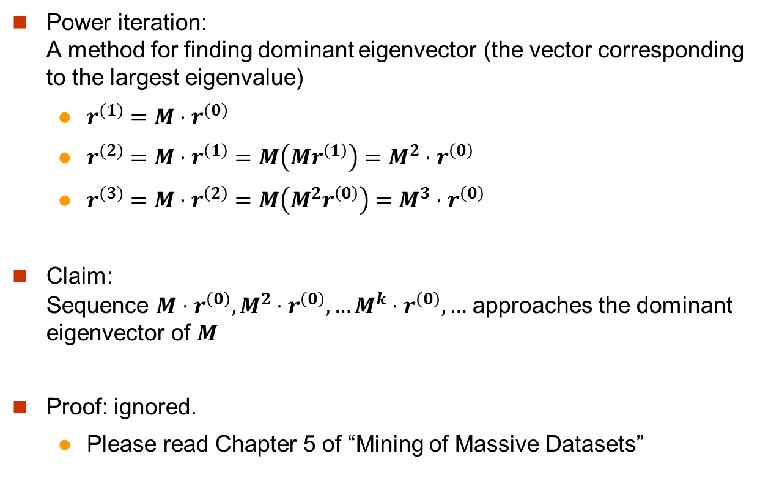
Why Power Iteration works?

Slide 56
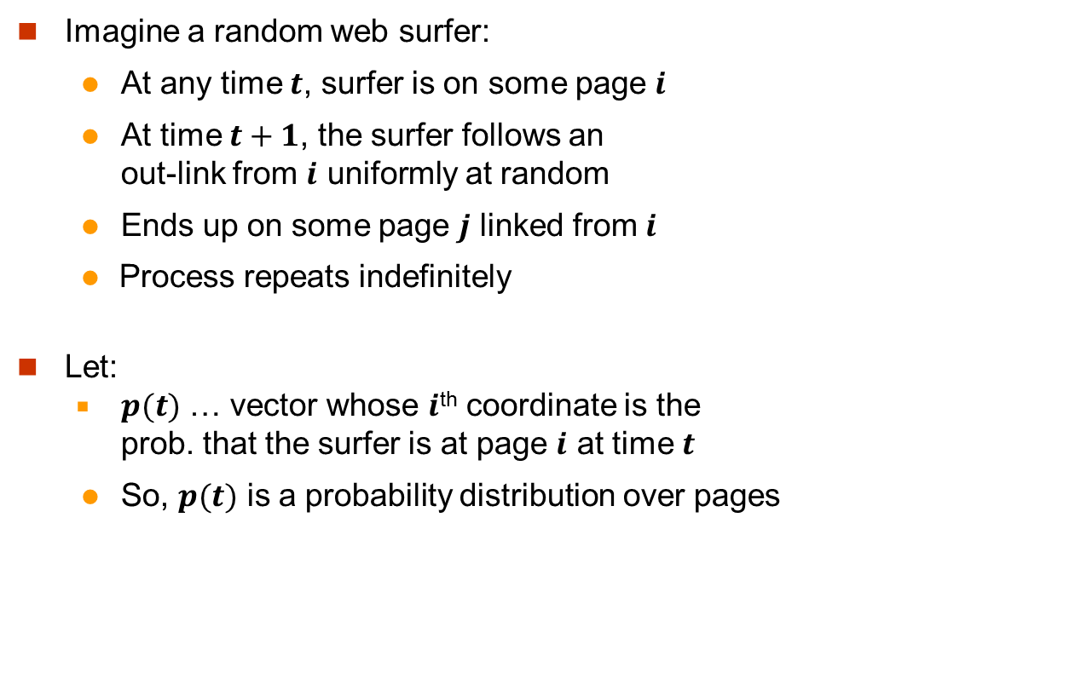
Random Walk Interpretation
i₁
i₂
i₃
j

Slide 57
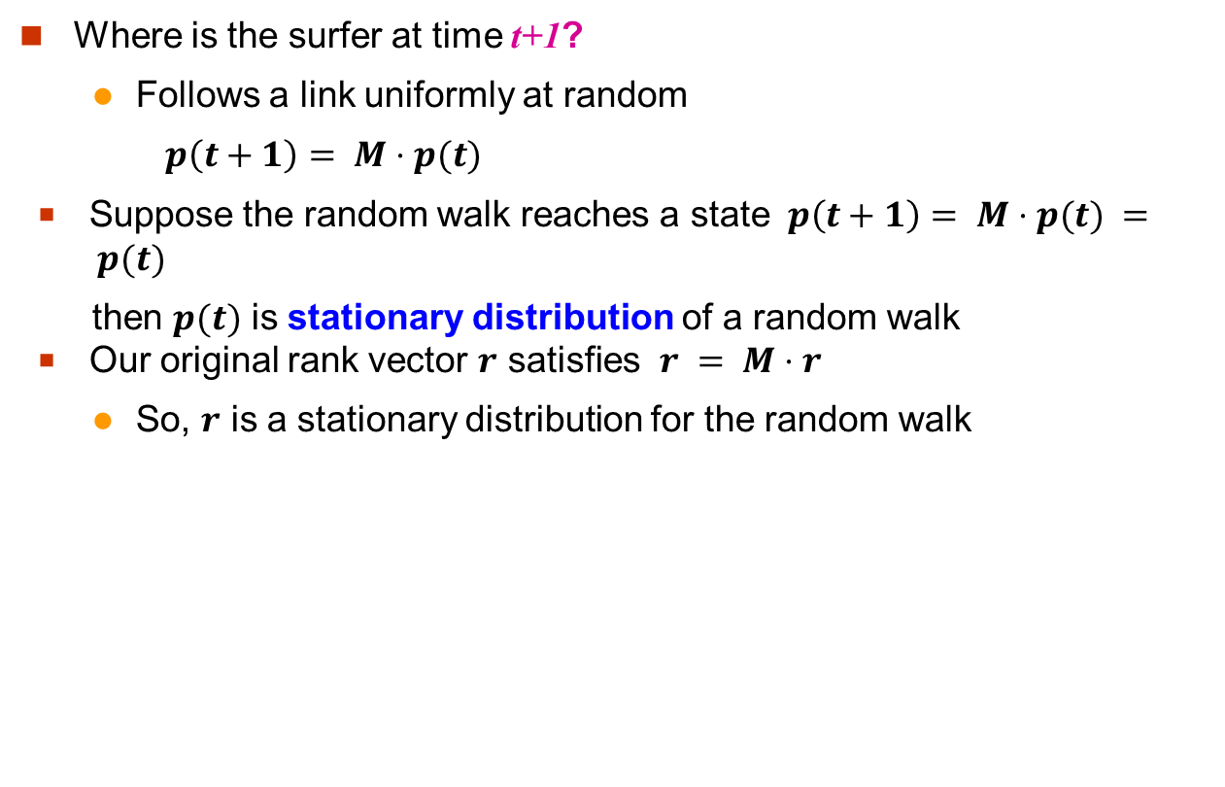
The Stationary Distribution
i₁
i₂
i₃
j

Slide 58
Existence and Uniqueness
A central result from the theory of random walks (a.k.a. Markov processes):
For graphs that satisfy certain conditions,
the stationary distribution is unique and eventually will be reached no matter what the initial probability distribution at time t = 0

Slide 59
PageRank: Two Questions
Does this converge?
Does it converge to what we want?
or
equivalently

Slide 60
Does this converge?
Example:
r_{a} 1 0 1 0 …
r_{b} 0 1 0 1 …
a
b
Iteration 0, 1, 2, …

Slide 61
Does it converge to what we want?
Example:
r_{a} 1 0 0 0
r_{b} 0 1 0 0
a
b
Iteration 0, 1, 2, …

Slide 62
PageRank: Problems
2 problems:
(1) Some pages are dead ends (have no out-links)
  Random walk has “nowhere” to go to
  Such pages cause importance to “leak out”
(2) Spider traps: (all out-links are within the group)
  Random walked gets “stuck” in a trap
  And eventually spider traps absorb all importance
Dead end
Spider trap

Slide 63
Problem: Dead Ends
y
 | y | a | m
y | ½ | ½ | 0
a | ½ | 0 | 0
m | 0 | ½ | 0
a
m
  r_{y} = r_{y} /2 + r_{a} /2
  r_{a} = r_{y} /2
  r_{m} = r_{a} /2
Iteration 0, 1, 2, …
Here the PageRank “leaks” out since the matrix is not stochastic.

Slide 64
Solution: Teleport!
Teleports: Follow random teleport links with probability 1.0 from dead-ends
  Adjust matrix accordingly
y
y
a
m
a
m
 | y | a | m
y | ½ | ½ | 0
a | ½ | 0 | 0
m | 0 | ½ | 0
 | y | a | m
y | ½ | ½ | ⅓
a | ½ | 0 | ⅓
m | 0 | ½ | ⅓

Slide 65
Problem: Spider Traps
y
 | y | a | m
y | ½ | ½ | 0
a | ½ | 0 | 0
m | 0 | ½ | 1
a
m
m is a spider trap
  r_{y} = r_{y} /2 + r_{a} /2
  r_{a} = r_{y} /2
  r_{m} = r_{a} /2 + r_{m}
Iteration 0, 1, 2, …
All the PageRank score gets “trapped” in node m.

Slide 66
Solution: Always Teleports!
The Google solution for spider traps: At each time step, the random surfer has two options
  With prob. β, follow a link at random
  With prob. 1-β, jump to some random page
  Common values for β are in the range 0.8 to 0.9
Surfer will teleport out of spider trap within a few time steps
y
y
a
m
a
m

Slide 67
Why Teleports Solve the Problem?
Why are dead-ends and spider traps a problem
and why do teleports solve the problem?
Spider-traps are not a problem, but with traps PageRank scores are not what we want
  Solution: Never get stuck in a spider trap by teleporting out of it in a finite number of steps
Dead-ends are a problem
  The matrix is not column stochastic so our initial assumptions are not met
  Solution: Make matrix column stochastic by always teleporting when there is nowhere else to go

Slide 68
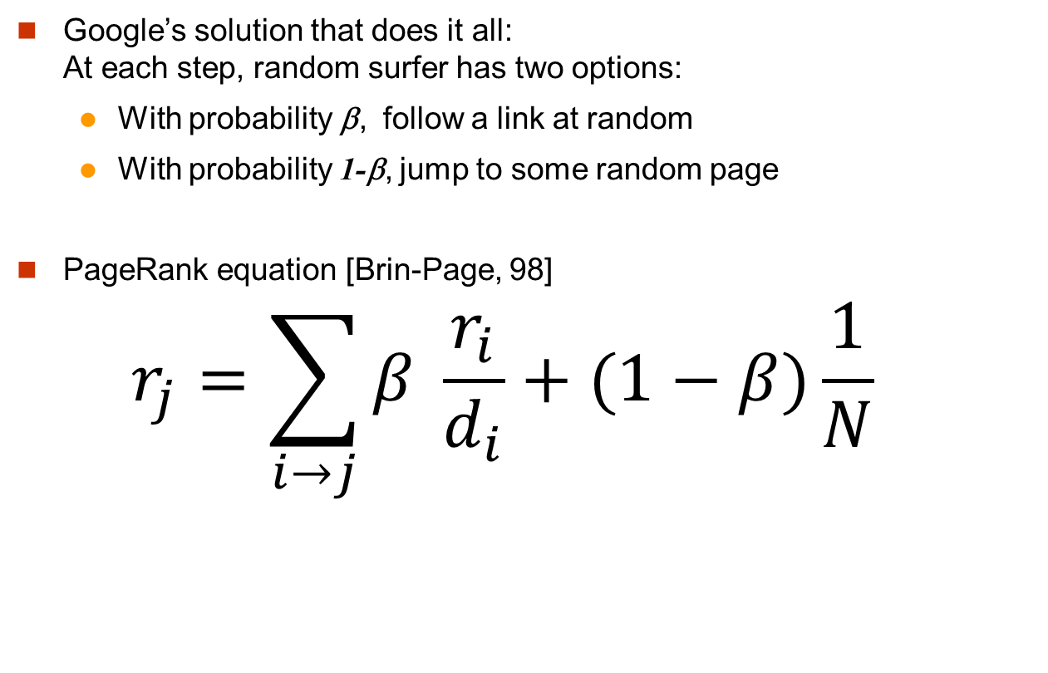
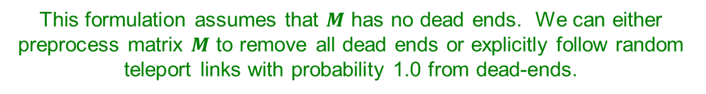
Google’s Solution: Random Teleports
d_{i} … out-degree
of node i

Slide 69
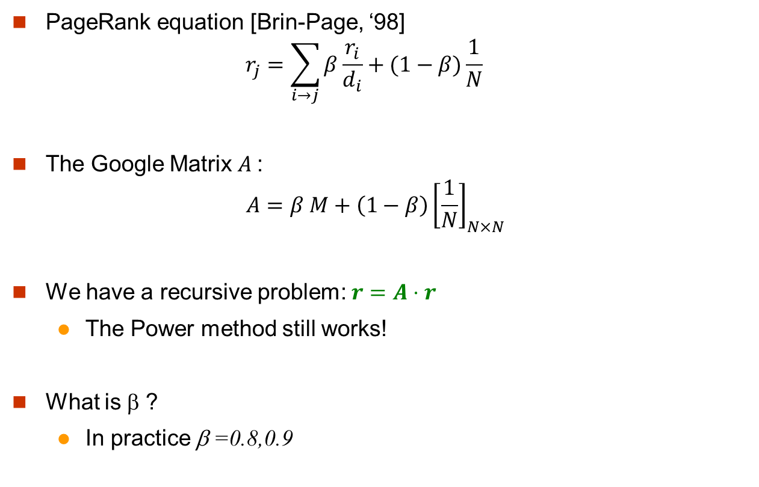
The Google Matrix

Slide 70
Random Teleports (β = 0.8)
M
  [1/N]_{NxN}
7/15
y
1/2 1/2 0
1/2 0 0
0 1/2 1
1/3 1/3 1/3
1/3 1/3 1/3
1/3 1/3 1/3
0.8
+ 0.2
7/15
1/15
7/15
1/15
y 7/15 7/15 1/15
a 7/15 1/15 1/15
m 1/15 7/15 13/15
13/15
a
7/15
m
1/15
1/15
A
y
a =
m
1/3
1/3
1/3
0.33
0.20
0.46
0.24
0.20
0.52
0.26
0.18
0.56
7/33
5/33
21/33
. . .

Slide 71
Computing PageRank
Key step is matrix-vector multiplication
  r^{new} = A ∙ r^{old}
Easy if we have enough main memory to hold A, r^{old}, r^{new}
Say N = 1 billion pages
  We need 4 bytes for
  each entry (say)
  2 billion entries for
  vectors, approx 8GB
  Matrix A has N² entries
    10¹⁸ is a large number!
  A = β∙M + (1-β) [1/N]_{NxN}
½ ½ 0
½ 0 0
0 ½ 1
1/3 1/3 1/3
1/3 1/3 1/3
1/3 1/3 1/3
A =
0.8
+0.2
7/15 7/15 1/15
7/15 1/15 1/15
1/15 7/15 13/15
=

Slide 72
Matrix Formulation
Suppose there are N pages
Consider page i, with d_{i} out-links
We have M_{ji} = 1/|d_{i}| when i → j
and M_{ji} = 0 otherwise
The random teleport is equivalent to:
  Adding a teleport link from i to every other page and setting transition probability to (1-β)/N
  Reducing the probability of following each
  out-link from 1/|d_{i}| to β/|d_{i}|
  Equivalent: Tax each page a fraction (1-β) of its score and redistribute evenly

Slide 73
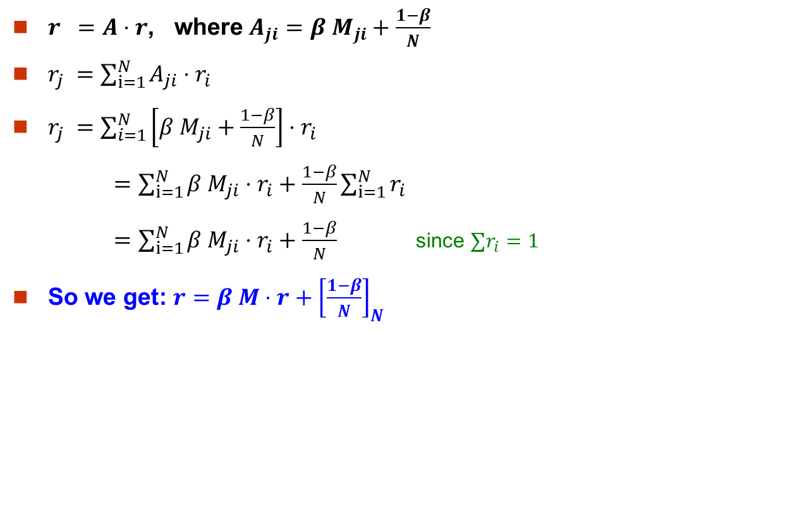
Rearranging the Equation
Note: Here we assumed M has no dead-ends
[x]_{N} … a vector of length N with all entries x

Slide 74
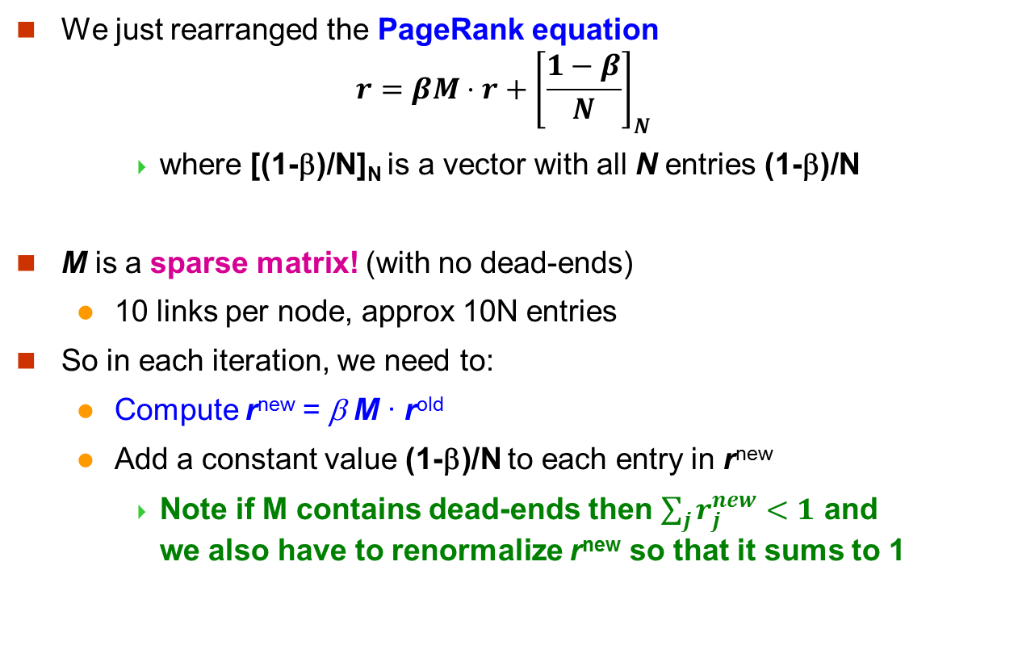
Sparse Matrix Formulation

Slide 75
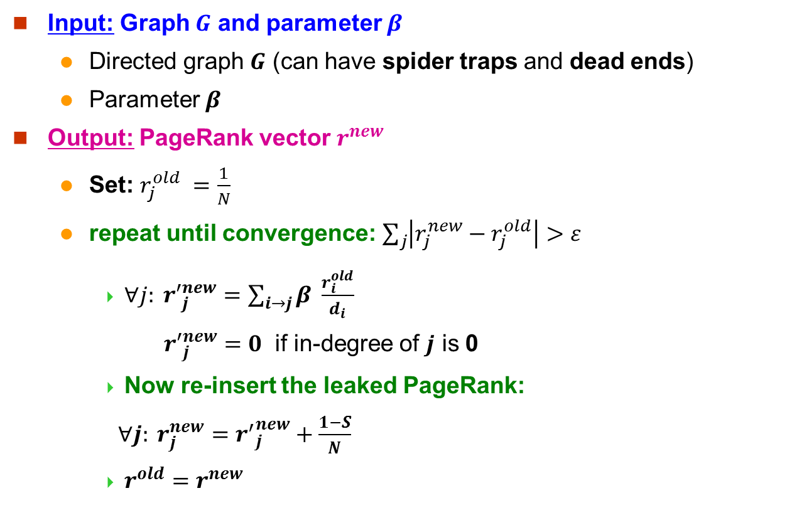
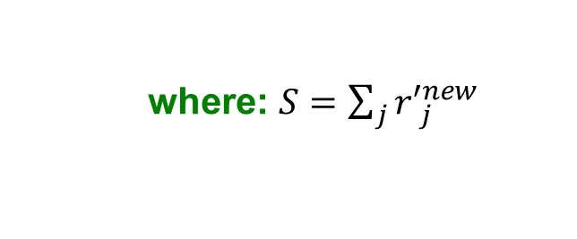
PageRank: The Complete Algorithm
    where: $S=\sum_{j}{{r′}_{j}^{new}}$
If the graph has no dead-ends then the amount of leaked PageRank is 1-β. But since we have dead-ends the amount of leaked PageRank may be larger. We have to explicitly account for it by computing S.

Slide 76
Sparse Matrix Encoding
Encode sparse matrix using only nonzero entries
  Space proportional roughly to number of links
  Say 10N, or 4*10*1 billion = 40GB
  Still won’t fit in memory, but will fit on disk
source
node
degree
destination nodes
0 | 3 | 1, 5, 7
1 | 5 | 17, 64, 113, 117, 245
2 | 2 | 13, 23

Slide 77
Basic Algorithm: Update Step
Assume enough RAM to fit r^{new} into memory
  Store r^{old} and matrix M on disk
1 step of power-iteration is:
Initialize all entries of r^{new} = (1-β) / N
For each page i (of out-degree d_{i}):
Read into memory: i, d_{i}, dest₁, …, dest_{di}, r^{old}(i)
For j = 1…d_{i}
r^{new}(dest_{j}) += β r^{old}(i) / d_{i}
0
r^{new}
source
degree
destination
r^{old}
0
1
0 | 3 | 1, 5, 6
1 | 4 | 17, 64, 113, 117
2 | 2 | 13, 23
1
2
2
3
3
4
4
5
5
6

Slide 78
Analysis
Assume enough RAM to fit r^{new} into memory
  Store r^{old} and matrix M on disk
In each iteration, we have to:
  Read r^{old} and M
  Write r^{new} back to disk
  Cost per iteration of Power method:
  = 2|r| + |M|
Question:
  What if we could not even fit r^{new} in memory?
  Split r^{new} into blocks. Details ignored

Slide 79
PageRank in MapReduce

Slide 80
PageRank Computation Review
Properties of PageRank
  Can be computed iteratively
  Effects at each iteration are local
Sketch of algorithm:
  Start with seed r_{i} values
  Each page distributes r_{i} “credit” to all pages it links to
  Each target page t_{j} adds up “credit” from multiple in-bound links to compute r_{j}
  Iterate until values converge

Slide 81
Simplified PageRank
First, tackle the simple case:
  No teleport
  No dead ends
Then, factor in these complexities…
  How to deal with the teleport probability?
  How to deal with dead ends?

Slide 82
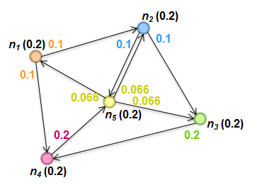
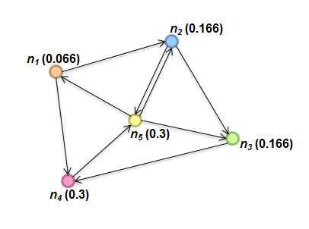
Sample PageRank Iteration (1)

Slide 83
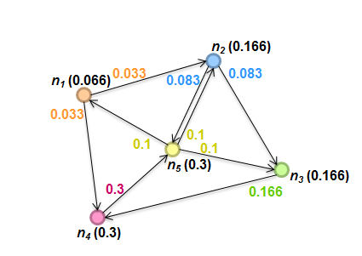
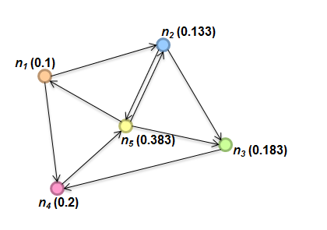
Sample PageRank Iteration (2)

Slide 84
PageRank in MapReduce (One Iteration)
n₁ [n₂, n₄]
n₂ [n₃, n₅]
n₃ [n₄]
n₄ [n₅]
n₅ [n₁, n₂, n₃]
Map
n₂
n₄
n₃
n₅
n₄
n₅
n₁
n₂
n₃
n₁
n₂
n₂
n₃
n₃
n₄
n₄
n₅
n₅
Reduce
n₁ [n₂, n₄]
n₂ [n₃, n₅]
n₃ [n₄]
n₄ [n₅]
n₅ [n₁, n₂, n₃]

Slide 85
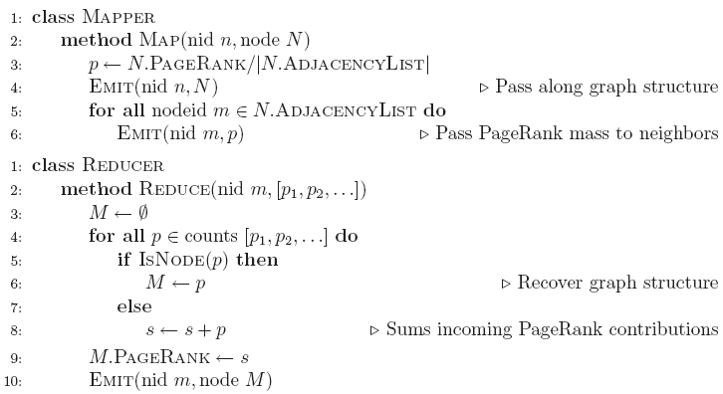
PageRank Pseudo-Code

Slide 86
PageRank vs. BFS
PageRank
BFS
Map
r_{i}/d_{i}
d+w
Reduce
sum
min

Slide 87
Complete PageRank
Two additional complexities
  What is the proper treatment of dangling nodes?
  How do we factor in the random jump factor?
Solution:
  If a node’s adjacency list is empty, distribute its value to all nodes evenly.
    In mapper, for such a node i, emit (nid m, r_{i}/N) for each node m in the graph
  Add the teleport value
    In reducer, M.PageRank = β * s + (1- β) / N

Slide 88
Graphs and MapReduce
Graph algorithms typically involve:
  Performing computations at each node: based on node features, edge features, and local link structure
  Propagating computations: “traversing” the graph
Generic recipe:
  Represent graphs as adjacency lists
  Perform local computations in mapper
  Pass along partial results via outlinks, keyed by destination node
  Perform aggregation in reducer on inlinks to a node
  Iterate until convergence: controlled by external “driver”
  Don’t forget to pass the graph structure between iterations

Slide 89
Issues with MapReduce on Graph Processing
MapReduce Does not support iterative graph computations:
  External driver. Huge I/O incurs
  No mechanism to support global data structures that can be accessed and updated by all mappers and reducers
    Passing information is only possible within the local graph structure – through adjacency list
    Dijkstra's algorithm on a single machine: a global priority queue that guides the expansion of nodes
    Dijkstra‘s algorithm in Hadoop, no such queue available. Do some “wasted” computation instead
MapReduce algorithms are often impractical on large, dense graphs.
  The amount of intermediate data generated is on the order of the number of edges.
  For dense graphs, MapReduce running time would be dominated by copying intermediate data across the network.

Slide 90
More Tools on Big Graph Processing
Graph databases: Storage and Basic Operators
  http://en.wikipedia.org/wiki/Graph_database
  Neo4j (an open source graph database)
  InfiniteGraph
  VertexDB
Distributed Graph Processing (mostly in-memory-only)
  Google’s Pregel (vertex centered computation)
  Giraph (Apache)
  GraphX (Spark)
  GraphLab
  … …

Slide 91
References
Chapter 5. Data-Intensive Text Processing with MapReduce
Chapter 5. Mining of Massive Datasets.

Slide 92
End of Chapter 5

