Slide 1
Web Technology Overview with a focus on JavaScript-based technologies
Lawrence Yao
l.yao@unsw.edu.au
Notes:
In this lecture I wish to give you a very quick introduction to JavaScript, the programming language, some of the associated libraries and related Web technologies, and lots of references for you to find out more about how to develop Web applications using JavaScript as the main programming language.

Slide 2
Who am I?
Lawrence Yao
UNSW casual staff
Developer Analyst at YTML Consulting
Email me if you need technical help or suggestions for your SENG project.

Slide 3

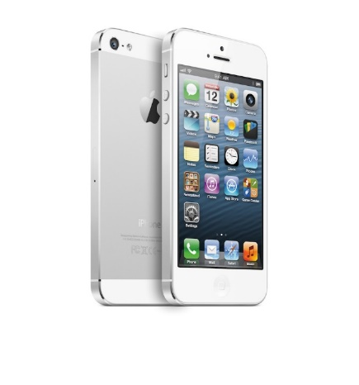


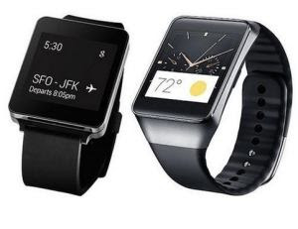

Continuing education
Employers will ask:
Your response:
What is exciting?
Notes:
Let’s start from the big picture.
Finished SENG and get a job out there in the “real” world. Employer will ask. “What is currently the exciting stuff that’s out there”? “What are the competition doing?” What would be your response?
Let me tell you about what I thought was exciting: programming financial calculators were exciting to me. Alas I never owned one, but I just thought, a programmable scientific calculator, how powerful would that be! I also thought the iPhone when it first came out was really exciting.
But then I think most of you are over that now. Perhaps you think the Google Glass or Android Wear is the exciting stuff now.
The I’m trying to get at, is that new and exciting things will continuingly pop up to replace what we know already, so it is important to keep learning. The same applies to what I’m showing you today, JavaScript may become outdated one day, and we will definitely see new JavaScript library versions that do things differently to what we do today. That’s why we have to keep on learning, even after we leave uni.
References:
http://www.google.com/glass/start/assets/img/homepage/dvf/homepage_lightbox_dvf_01.jpg

Slide 4
When learning coding,
be brave
Notes:
That’s why, we have to be prepared to get our hands dirty, try the latest things, use the latest programming languages and play with their newest libraries.

Slide 5
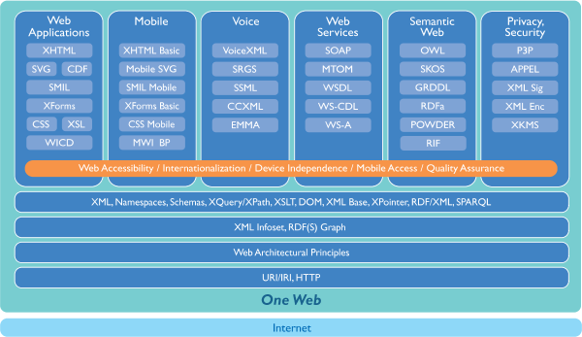
Web Technology Architecture
From: http://www.w3.org/Consortium/techstack-desc.html
Notes:
Stack: all of the systems and services that comes together to fulfil an end-to-end request.
Or the largest box that you can draw around the things you control.

Slide 6
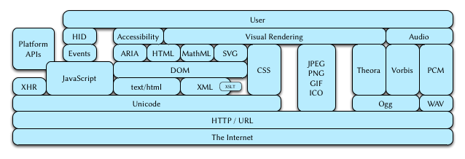
Web Browser Technology Architecture
From: https://hsivonen.fi/web-stack/

Slide 7
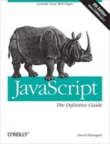
JavaScript
Highly recommended!!!
Online access through UNSW library
Learn all about the JavaScript programming language
JavaScript: The Definitive Guide, 6th ed.
By: David Flanagan
Publisher: O'Reilly Media, Inc.
Pub. Date: May 3, 2011
Notes:
If you want to know every bit of fundamental knowledge (which is useful) about JavaScript the language, then I highly recommend this book. The book is available for online viewing through UNSW library, so no need to fight over a copy of it for loan.
The book is extremely useful if you have minimal JavaScript programming experience, it can also be used as a reference book by seasoned JavaScript programmers.

Slide 8

JavaScript on client and server
Internet (the Cloud)
Server-side JavaScript Web server with Node.js
Client-side JavaScript within Chrome, Firefox, Internet Explorer…
Notes:
Explain that JavaScript has now been used on both client and server, so it is not just a scripting language for Web browsers. One way to think about it is that JavaScript has always been associated with a context, where a context can be the Web browser, or a server platform such as Node.js.
In this lecture we will first discuss server-side JavaScript with Node.js, and then client-side JavaScript.

Slide 9
Companion Web application
Mash: The “supported” Web application
  https://github.com/mlawry/unsw-cse-seng-mash-webapp
  Covers all technologies discussed
  Study it in your own time
  Ask me any questions about it via email

Slide 10
Server-side JavaScript

Slide 11
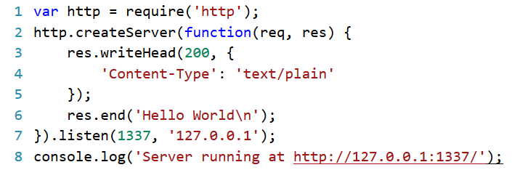
http://nodejs.org/
This simple web server written in Node responds with “Hello World” for every request.
Notes:
On the server side, we can use the node.js platform to develop a Web server listening on port 1337 using JavaScript.
For more examples, visit the Node.js web site.

Slide 12
Node.js
How does it work? Read these tutorials
  http://www.nodebeginner.org/
    Highly recommended, but not entirely free
    Provides enough knowledge to understand MASH
  http://code.tutsplus.com/tutorials/this-time-youll-learn-node-js--net-19448
    Outdated (v0.4.5)
Official API
  http://nodejs.org/api/
Notes:
I suggest you visit these Web sites to learn how to use Node.js.

Slide 13
Classic LAMP stack
Apache Httpd (Web server)
PHP (server-side programming)
MySQL (database)
Linux (operating system)

Slide 14
From LAMP to Node.js
Apache Httpd (Web server)
PHP (server-side programming)
MySQL (database)
Linux (operating system)

Slide 15
From LAMP to Node.js
Apache Httpd (Web server)
PHP (server-side programming)
MySQL (database)
Linux (operating system)
Notes:
Explain how a HTTP request is handled… It goes from HTTP listener to a Router, then a Request handler etc.

Slide 16
Node.js architecture
User developed modules… Third party modules…
Event Loop Library
Thread Pool Library
Stream Socket Library
HTTP Parser
DNS Resolver
JavaScript Engine (Google V8)
MySQL (database)
Linux (operating system)
Based on slides from: http://s3.amazonaws.com/four.livejournal/20091117/jsconf.pdf
Notes:
This is the end of my talk on Node.js and server-side JavaScript.

Slide 17
From Node.js to MEAN
User developed modules… Third party modules…
Event Loop Library
Thread Pool Library
Stream Socket Library
HTTP Parser
DNS Resolver
JavaScript Engine (Google V8)
MySQL (database)
Linux (operating system)

Slide 18
From Node.js to MEAN
Node.js (HTTP server & server-side programming)
MySQL (database)
Linux (operating system)

Slide 19
From Node.js to MEAN
Node.js (HTTP server & server-side programming)
MySQL (database)
Linux (operating system)

Slide 20
From Node.js to MEAN
Express + Node.js (HTTP server & server-side programming)
MySQL (database)
Linux (operating system)

Slide 21
MEAN stack
AngularJS (Client-side programming)
Express + Node.js (HTTP server & server-side programming)
MongoDB (database)
Linux (operating system)

Slide 22
Client-side JavaScript

Slide 23
HTML DOM
To see the Document Object Model (DOM)
  Open Web browser
  Go to any Web page
  Press F12 on keyboard to bring up the “Web Developer Tools” (works for Firefox and IE)
  (IE10) Don’t forget to refresh DOM
  Type JavaScript directly in the Console
DOM can be changed without reloading entire Web page
  Manually: Web Developer Tools
  Programmatically: JavaScript
Notes:
A basic Web page starts with some HTML mark up code. The HTML mark up is converted into a Document Object Model when displayed in a Web browser. We can inspect the Document Object Model in a Web browser.
We can also change the DOM without refreshing or reloading the Web page. This is essentially how a Web page moves from been a visually static experience to provide a dynamic or responsive or interactive.

Slide 24
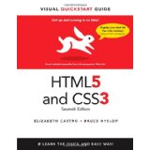
Cascading Style Sheets
HTML5 and CSS3
Elizabeth Castro and Bruce Hyslop
7th ed. Berkeley, Calif. : Peachpit, c2012
Checked out at Main Library Level 3 (006.74/5)
HTML: content; CSS: formatting
Colour, margin, position, animation, etc…
Specified in-line or in a separate .css file
CSS can be changed without reloading
  Manually: Web Developer Tools
  Programmatically: JavaScript
Notes:
While HTML controls the content of a Web page, CSS controls the formatting of the content and the page. CSS enables formatting elements to be grouped together in a separate file, so that you do not have to embed explicit formatting tags in a HTML document. Keeping HTML content and CSS formatting apart is extremely useful, because it allow us to develop themes for styling Web pages separately from the content. We will see this when we talk about Bootstrap and front-end frameworks.

Slide 25
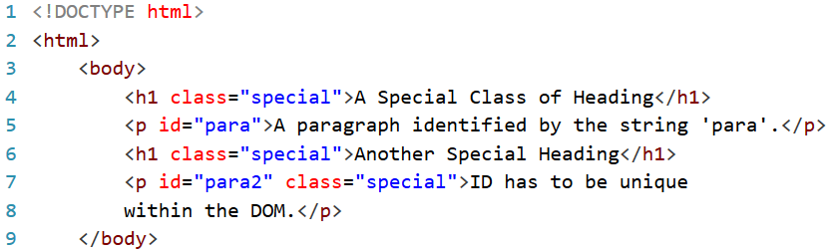
CSS selectors
Notes:
Before I show you what CSS styles look like, I need to explain one of the most important concept in CSS technology, which is that of selectors. You use selectors to identify DOM elements to apply styles to.
Here we see a simple Web page example. I will use this example to demonstrate how selectors work.

Slide 26
CSS selectors
Tag: Select all DOM elements with <Tag>
  “p”, “h1”
Tag#ID: Selects a unique <Tag> elem with the given ID
  “p#para”, “p#para2”
Tag.Class: Selects all <Tag> elems with the given Class
  “h1.special”, “p.special”
#ID: Selects a unique element (any tag) with the given ID
  “#para”, “#para2”
.Class: Selects all elements having the given Class
  “.special”
Notes:
[Go through the different types of selectors and say what they select in the previous example.]
These are not the only selector types available, there are quite a few more for you to discover on your own. But these are the most common types of selectors used.

Slide 27
CSS style sheet (.css)
body {
line-height:1;
text-align:left;
text-align:start
}
menu.small,ol,ul {
list-style:none
}
.yt-embed-thumbnail {
width:100%;
height:100%;
cursor:pointer;
background-size:cover;
background-repeat:no-repeat;
background-position:center
}
Notes:
Declaration block, property, value
Before the opening brace we have the selector, which identifies the DOM elements a set of styles applies to. In between the pair of braces we have the actual styles that describes how the selected elements should be formatted. This slide shows three sets of styles.

Slide 28
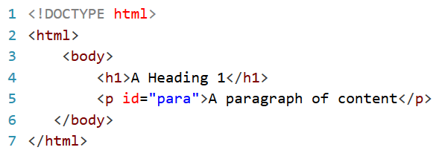

JavaScript
Guide: https://developer.mozilla.org/en-US/docs/Web/JavaScript
W3C DOM specification: http://www.w3.org/DOM/DOMTR
Notes:
JavaScript can be used to change the styling of DOM elements or change the structure of DOM elements, so as to achieve a dynamic Web page. To retrieve DOM elements to change, a syntax similar to selectors is used. You simply make an API call to obtain the DOM element, and then change the element’s attributes. In this example….
You can also get elements by class name in a similar manner to the example shown here. The methods used to access DOM elements are standardised by the W3C DOM specification, which you can read more about using the link shown here. The document variable is usually provided by the Web browser that executes the JavaScript code.

Slide 29
Web browser
Provides an environment to run JavaScript
  The JavaScript code changes the DOM/CSS
  DOM/CSS changes >> dynamic Web page
Ties things together
  Reads HTML and CSS, creates DOM, applies CSS, executes JavaScript, interprets result as the final Web page
Notes:
Talk about the role of the Web browser.
It reads HTML page and associated CSS files from server, then creates a DOM and applies the CSS styles. Then JavaScript code is executed that may alter the DOM. Finally, the resulting DOM is interpreted into a visual representation for the end-user’s consumption.

Slide 30
Ajax
Asynchronous JavaScript and XML
Partially update a Web page in reaction to some event
  No need to refresh entire Web page
  Smoother user experience (less disruptive)
Relies on Web browser functionality
  Exposed as XMLHttpRequest (XHR) API
Usually send/receive JSON in background
  JSON data format: http://json.org/

Slide 31
Front-End Frameworks
A compilation of complementary display elements that works like a theme
  Focus on responsive design
Bootstrap: http://getbootstrap.com/
  A popular HTML, CSS, and JS framework for developing responsive, mobile first projects on the web
Foundation: http://foundation.zurb.com/
Demo Grid system: http://getbootstrap.com/examples/grid/
Notes:
This is where separation of content and styling into separate files help.

Slide 32
jQuery JavaScript library
W3C DOM API is tedious and verbose
jQuery is succinct and convenient
Defines a global variable $ (or jQuery)
Notes:
jQuery uses selectors to identify DOM elements to change. It also provides a lot of often used functionality to make the life of an interactive Web programmer easier.

Slide 33
jQuery
API Doc: http://api.jquery.com/
Cook book: http://stackoverflow.com/questions/tagged/jquery
Let’s play
  JSFiddle http://jsfiddle.net/
  Don’t forget to View Source on the Result frame
Notes:
JSFiddle is an sandbox environment for you to quickly write small snippets of HTML, CSS, and JavaScript and see how it works.

Slide 34
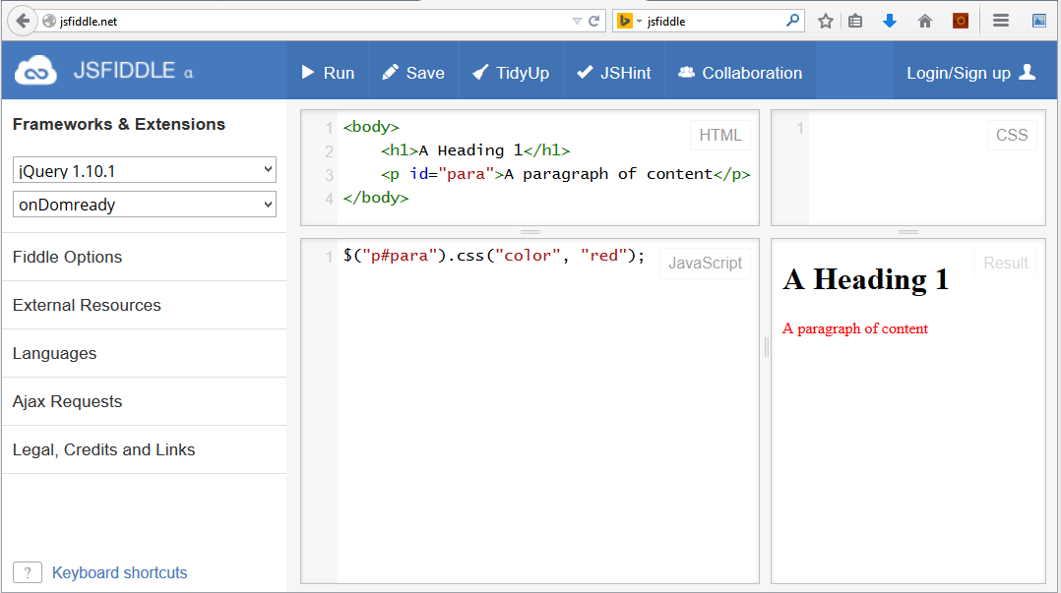
JSFiddle
Notes:
Just a screen shot in case I don’t (or cannot) show http://jsfiddle.net because there is no Internet connection.

Slide 35
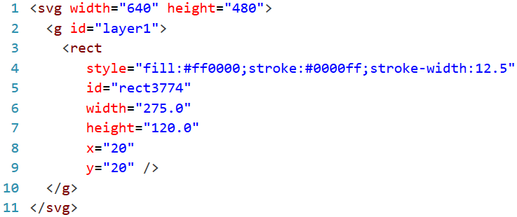
SVG
Scalable Vector Graphics (SVG)
  Vector graphics in XML
  Specification: http://www.w3.org/TR/SVG/Overview.html
Notes:
As you can see, it combines elements from HTML and CSS.

Slide 36
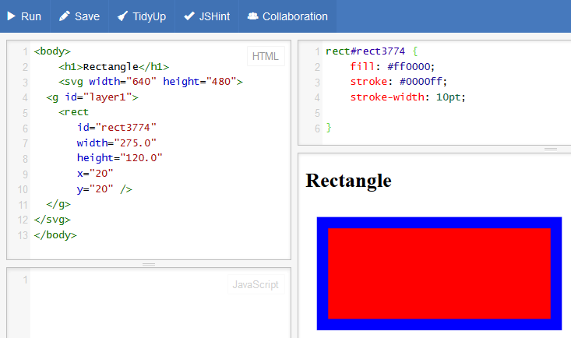
SVG in JSFiddle
Notes:
In this case, I have applied the style using a CSS declaration block.

Slide 37
Web graphics
Great graphics = HTML + CSS + SVG
  View in any browser, always sharp, quick to load
  But static!!
Great visualisation needs interactivity
Great visualisations =
HTML + CSS + SVG + JavaScript (D3.js)
Notes:
With SVG technology, we can now develop great Web graphics.
Where D3 library fits in, is in the development of great visualisations.

Slide 38

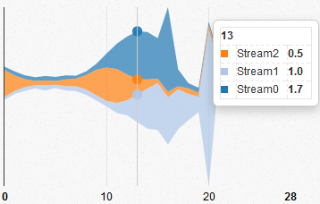
Data-Driven Documents
D3.js JavaScript library: http://d3js.org/
+ HTML + CSS + SVG
JavaScript
Data
Great Visualisation
Notes:
D3 takes raw data and process It through JavaScript in combination with HTML, CSS and SVG to produce great visualisations viewable in a Web browser.

Slide 39
D3.js
How does D3 work? Find out here
https://github.com/mbostock/d3/wiki/Tutorials
In particular:
  Three Little Circles http://bost.ocks.org/mike/circles/
  D3 Tutorials – Scott Murray http://alignedleft.com/tutorials/d3/
  Example gallery
  https://github.com/mbostock/d3/wiki/Gallery

Slide 40
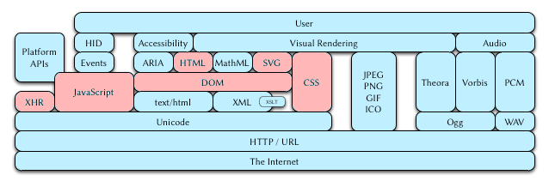
Web Browser Technology Architecture
From: https://hsivonen.fi/web-stack/
Notes:
As you can see, we have only touched on a small part of the whole Web browser technology stack.
But the technologies we did talk about is already more than enough to develop a great infographics Web site.
The Web technology space is really big indeed.

Slide 41
Putting Everything Together
Mash: A “supported” Web application
  https://github.com/mlawry/unsw-cse-seng-mash-webapp
  Study it in your own time
  Ask me any questions about it via email
  Bug fixes welcome (submit issues via GitHub)
Mash uses:
  Client-side: HTML + CSS + SVG + JavaScript + Ajax (D3.js, jQuery, Bootstrap)
  Server-side: Node.js
  Use it as a template for your project!
Notes:
Mash uses technologies
Mash uses frameworks and libraries.

Slide 42
Some hints on starting your project

Slide 43
Node.js tooling
Node.js on (recent versions of) Linux
  Install using system package manager
    Debian/Ubuntu: nodejs, npm
  Use command line and a text editor
  Integrated Development Environments
    Eclipse (search “eclipse node.js”)
    NetBeans (search “netbeans node.js”)

Slide 44
Node.js tutorials (Linux)
http://www.nodeclipse.org/ubuntu/linux/java/nodejs/2015/2015/07/09/Starting-with-Java-and-Node.js-development-on-Ubuntu-Linux.html
Netbeans Nodejs Plugin: https://github.com/timboudreau/nb-nodejs
Command line: http://blog.modulus.io/absolute-beginners-guide-to-nodejs

Slide 45
Node.js for Windows users
Option 1: Switch to Linux?
Option 2: Use Eclipse or NetBeans?
Option 3: Use Node.js Tools for Visual Studio
  Visual Studio 2013 Community Edition
  Node.js Tools for Visual Studio
  Node.js for Windows (MSI 64-bit)

Slide 46
Node.js tutorials (Windows)
https://channel9.msdn.com/Blogs/Seth-Juarez/Nodejs-Tools-for-Visual-Studio
  Includes a demo on deployment to Azure (if you want to use it)

Slide 47
Tutorial on Express framework
Express via the command line https://codeforgeek.com/2014/10/express-complete-tutorial-part-1/
Deploy node.js apps to Heroku (free hosting service – conditions apply) https://devcenter.heroku.com/articles/getting-started-with-nodejs#introduction

Slide 48
Some UI examples
Examples:
  http://www.nytimes.com/newsgraphics/2013/09/13/fashion-week-editors-picks/
  http://www.nytimes.com/interactive/2014/02/11/sports/sochi-2014-interactive-stories.html
  http://onedrive.live.com/

Slide 49
Thank You
Questions?
Email me: l.yao@unsw.edu.au
Remember
When learning coding, be brave
Acknowledgments
Lecture notes from Kenny Sabir

