Slide 1


DESN2000 24T2 Lec12
Stepper Motors
2024
Hammond Pearce
Includes material from
“Chapter 15, Stepper Motors,
Dr. Yifeng Zhu / U. of Maine”

Slide 2
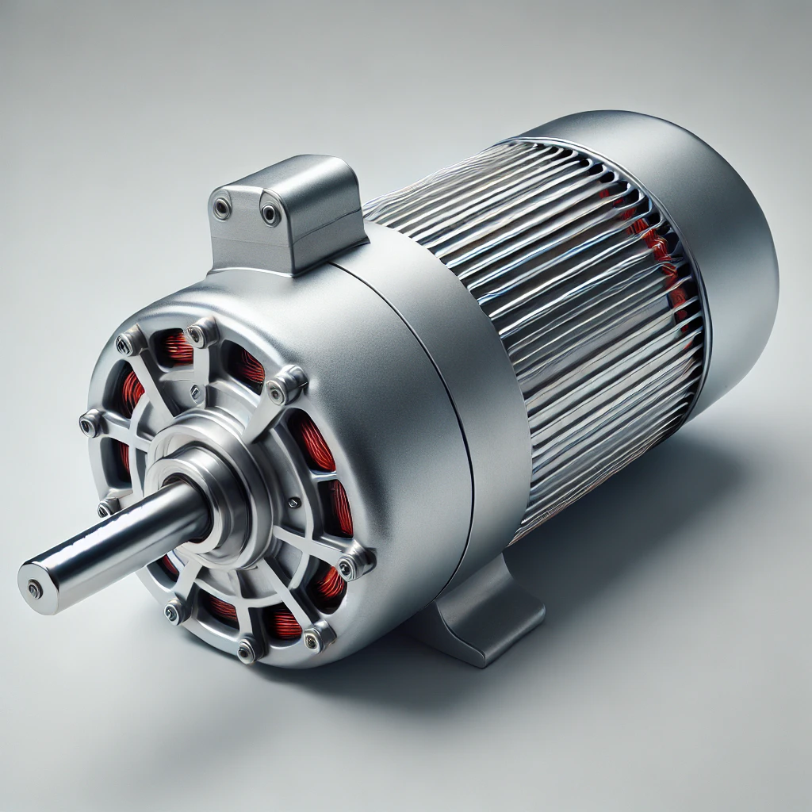
What is a motor?
Convert electrical energy into mechanical motion or work.
Essential in powering devices, vehicles, and machinery.
Types include AC, DC, stepper, and servo motors.
Used everywhere you can imagine:
  Electric cars, robots, factory equipment
  Vacuum cleaners, elevators, roller doors
  Microwaves and ovens (fans, turntable)
  Computer fans and older HDDs/disk drives
  Inside digital cameras and printers

Slide 3
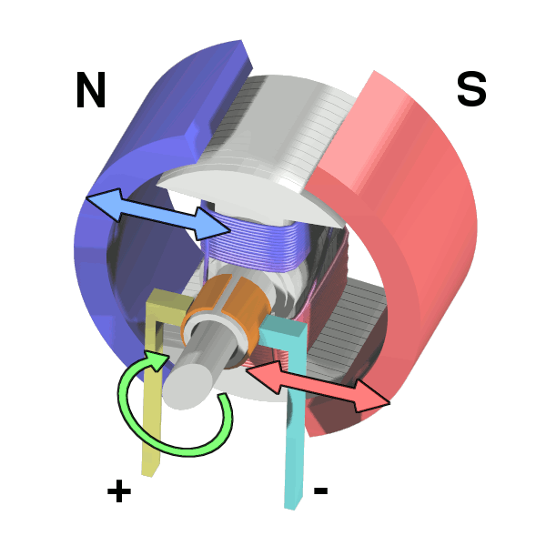
Typical DC motors
The image shows a “brushed” motor
It has a two-pole rotor (armature) and permanent magnet stator
When the circuit energizes it pulls each coil towards the appropriate magnet
https://en.wikipedia.org/wiki/DC_motor#/media/File:Electric_motor_cycle_2.png

Slide 4
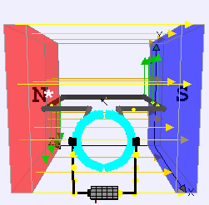
Example
https://en.wikipedia.org/wiki/DC_motor#/media/File:Ejs_Open_Source_Direct_Current_Electrical_Motor_Model_Java_Applet_(_DC_Motor_)_80_degree_split_ring.gif

Slide 5
Stepper motors
Normal motors provide continuous rotation
  … how do you know how far it has turned?
    Add another sensor? E.g. shaft encoder?
Alternatively, we could use another design of motor:
Stepper motors provide discrete, precise steps.
  Enables precise control: you know how much the motor has moved
  Doesn’t require feedback for positioning
Used in robotics, 3D printers, CNC machines, cameras…

Slide 6
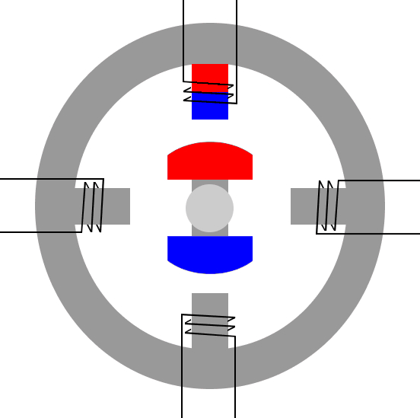
Example
https://drufelcnc.com/?c=blog&p=Stepper_motors

Slide 7
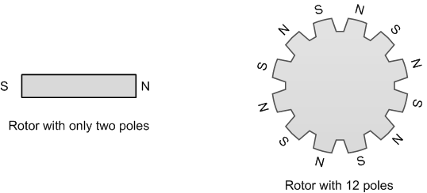
Differing number of poles
= Change in step angle size

Slide 8
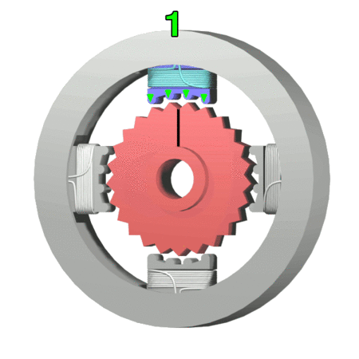
More poles = Smaller angle
= More steps for complete revolution
https://en.wikipedia.org/wiki/Stepper_motor#/media/File:StepperMotor.gif

Slide 9
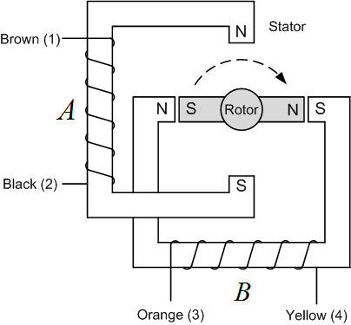
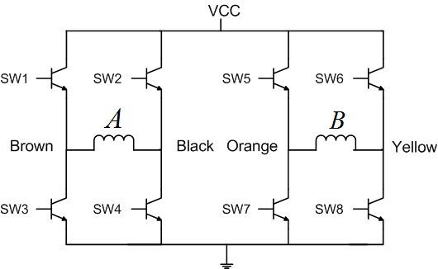
Differing wiring methods:
Bipolar Stepper Motor

Slide 10
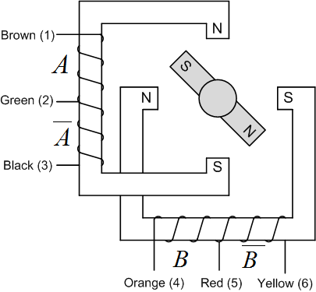
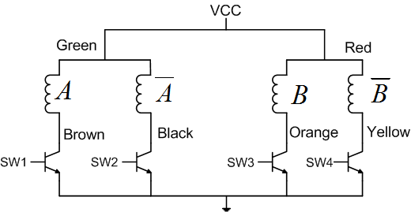
Differing wiring methods:
Unipolar Stepper Motor

Slide 11
Differing wiring methods:
Unipolar Stepper Motor
Simpler circuit! But…
…Less magnetic torque

Slide 12
Stepping Methods

Slide 13
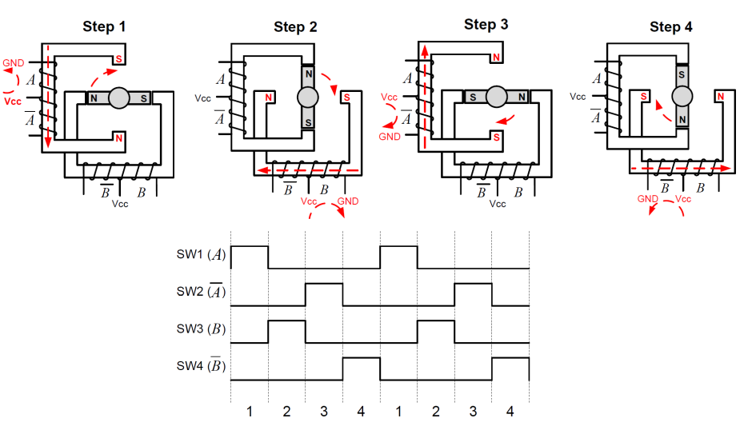
Wave Stepping
COIL_B | Pink
COIL_D | Orange
COIL_A | Blue
COIL_C | Yellow

Slide 14
Wave Stepping

Slide 15
Wave stepping in code
int step = 0;
while(1) {
if(step == 0) {
HAL_GPIO_WritePin(COIL_B_GPIO_Port, COIL_B_Pin, 0);
HAL_GPIO_WritePin(COIL_A_GPIO_Port, COIL_A_Pin, 1);
} else if(step == 1) {
HAL_GPIO_WritePin(COIL_A_GPIO_Port, COIL_A_Pin, 0);
HAL_GPIO_WritePin(COIL_D_GPIO_Port, COIL_D_Pin, 1);
} else if(step == 2) {
HAL_GPIO_WritePin(COIL_D_GPIO_Port, COIL_D_Pin, 0);
HAL_GPIO_WritePin(COIL_C_GPIO_Port, COIL_C_Pin, 1);
} else if(step == 3) {
HAL_GPIO_WritePin(COIL_C_GPIO_Port, COIL_C_Pin, 0);
HAL_GPIO_WritePin(COIL_B_GPIO_Port, COIL_B_Pin, 1);
}
step++;
step = step % 4;
}

Slide 16
Wave stepping
Advantages:
  Simple control: Easy implementation with basic circuits.
  Low power: Consumes less power than other stepping modes.
Disadvantages:
  Low torque: Produces less torque compared to other methods.
  Vibration: Increased vibration and noise during operation.
  Less smooth: Provides less smooth motion than other stepping modes.

Slide 17
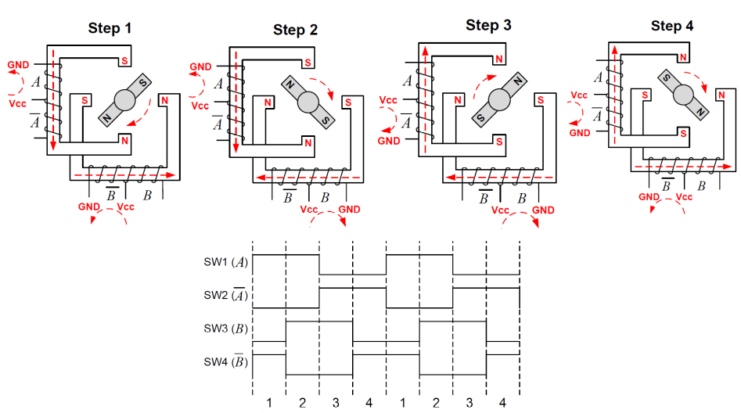
Full stepping
COIL_B | Pink
COIL_D | Orange
COIL_A | Blue
COIL_C | Yellow

Slide 18
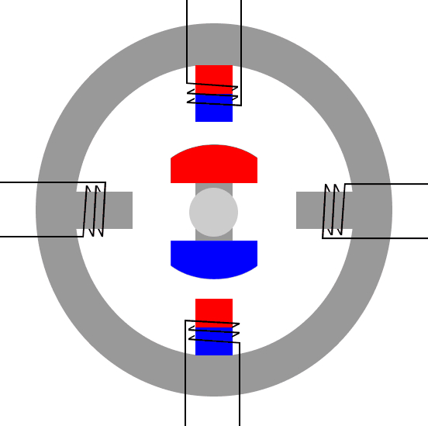
Full stepping

Slide 19
Full stepping in code
int step = 0;
while(1) {
if(step == 0) {
HAL_GPIO_WritePin(COIL_B_GPIO_Port, COIL_B_Pin, 1);
HAL_GPIO_WritePin(COIL_D_GPIO_Port, COIL_D_Pin, 0);
HAL_GPIO_WritePin(COIL_A_GPIO_Port, COIL_A_Pin, 0);
HAL_GPIO_WritePin(COIL_C_GPIO_Port, COIL_C_Pin, 1);
} else if(step == 1) {
HAL_GPIO_WritePin(COIL_B_GPIO_Port, COIL_B_Pin, 1);
HAL_GPIO_WritePin(COIL_D_GPIO_Port, COIL_D_Pin, 0);
HAL_GPIO_WritePin(COIL_A_GPIO_Port, COIL_A_Pin, 1);
HAL_GPIO_WritePin(COIL_C_GPIO_Port, COIL_C_Pin, 0);
} else if(step == 2) {
HAL_GPIO_WritePin(COIL_B_GPIO_Port, COIL_B_Pin, 0);
HAL_GPIO_WritePin(COIL_D_GPIO_Port, COIL_D_Pin, 1);
HAL_GPIO_WritePin(COIL_A_GPIO_Port, COIL_A_Pin, 1);
HAL_GPIO_WritePin(COIL_C_GPIO_Port, COIL_C_Pin, 0);
} else if(step == 3) {
HAL_GPIO_WritePin(COIL_B_GPIO_Port, COIL_B_Pin, 0);
HAL_GPIO_WritePin(COIL_D_GPIO_Port, COIL_D_Pin, 1);
HAL_GPIO_WritePin(COIL_A_GPIO_Port, COIL_A_Pin, 0);
HAL_GPIO_WritePin(COIL_C_GPIO_Port, COIL_C_Pin, 1);
}
step++;
step = step % 4;
}

Slide 20
Full stepping
Advantages:
  High torque: Produces higher torque than wave stepping.
  Better stability: Provides more stable operation and positioning.
Disadvantages:
  Higher power: Consumes more power compared to wave stepping.

Slide 21
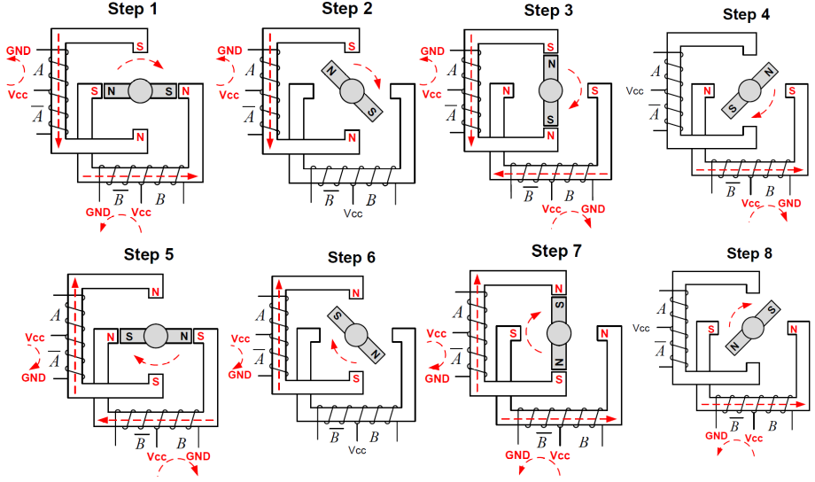
Half stepping

Slide 22
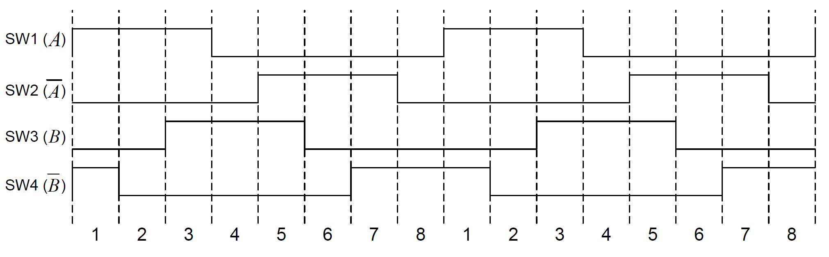
Half stepping
COIL_B | Pink
COIL_D | Orange
COIL_A | Blue
COIL_C | Yellow

Slide 23

Half stepping

Slide 24
Half stepping (alternative method)

Slide 25
Half stepping in code
} else if(step == 4) {
HAL_GPIO_WritePin(COIL_B_GPIO_Port, COIL_B_Pin, 0);
HAL_GPIO_WritePin(COIL_D_GPIO_Port, COIL_D_Pin, 1);
HAL_GPIO_WritePin(COIL_A_GPIO_Port, COIL_A_Pin, 1);
HAL_GPIO_WritePin(COIL_C_GPIO_Port, COIL_C_Pin, 0);
} else if(step == 5) {
HAL_GPIO_WritePin(COIL_B_GPIO_Port, COIL_B_Pin, 0);
HAL_GPIO_WritePin(COIL_D_GPIO_Port, COIL_D_Pin, 1);
HAL_GPIO_WritePin(COIL_A_GPIO_Port, COIL_A_Pin, 0);
HAL_GPIO_WritePin(COIL_C_GPIO_Port, COIL_C_Pin, 0);
} else if(step == 6) {
HAL_GPIO_WritePin(COIL_B_GPIO_Port, COIL_B_Pin, 0);
HAL_GPIO_WritePin(COIL_D_GPIO_Port, COIL_D_Pin, 1);
HAL_GPIO_WritePin(COIL_A_GPIO_Port, COIL_A_Pin, 0);
HAL_GPIO_WritePin(COIL_C_GPIO_Port, COIL_C_Pin, 1);
} else if(step == 7) {
HAL_GPIO_WritePin(COIL_B_GPIO_Port, COIL_B_Pin, 0);
HAL_GPIO_WritePin(COIL_D_GPIO_Port, COIL_D_Pin, 0);
HAL_GPIO_WritePin(COIL_A_GPIO_Port, COIL_A_Pin, 0);
HAL_GPIO_WritePin(COIL_C_GPIO_Port, COIL_C_Pin, 1);
}
step++;
step = step % 8;
}
int step = 0;
while(1) {
if(step == 0) {
HAL_GPIO_WritePin(COIL_B_GPIO_Port, COIL_B_Pin, 1);
HAL_GPIO_WritePin(COIL_D_GPIO_Port, COIL_D_Pin, 0);
HAL_GPIO_WritePin(COIL_A_GPIO_Port, COIL_A_Pin, 0);
HAL_GPIO_WritePin(COIL_C_GPIO_Port, COIL_C_Pin, 1);
} else if(step == 1) {
HAL_GPIO_WritePin(COIL_B_GPIO_Port, COIL_B_Pin, 1);
HAL_GPIO_WritePin(COIL_D_GPIO_Port, COIL_D_Pin, 0);
HAL_GPIO_WritePin(COIL_A_GPIO_Port, COIL_A_Pin, 0);
HAL_GPIO_WritePin(COIL_C_GPIO_Port, COIL_C_Pin, 0);
} else if(step == 2) {
HAL_GPIO_WritePin(COIL_B_GPIO_Port, COIL_B_Pin, 1);
HAL_GPIO_WritePin(COIL_D_GPIO_Port, COIL_D_Pin, 0);
HAL_GPIO_WritePin(COIL_A_GPIO_Port, COIL_A_Pin, 1);
HAL_GPIO_WritePin(COIL_C_GPIO_Port, COIL_C_Pin, 0);
} else if(step == 3) {
HAL_GPIO_WritePin(COIL_B_GPIO_Port, COIL_B_Pin, 0);
HAL_GPIO_WritePin(COIL_D_GPIO_Port, COIL_D_Pin, 0);
HAL_GPIO_WritePin(COIL_A_GPIO_Port, COIL_A_Pin, 1);
HAL_GPIO_WritePin(COIL_C_GPIO_Port, COIL_C_Pin, 0);

Slide 26
Half stepping
Advantages:
  Improved precision: Offers better positioning accuracy than full stepping.
  Reduced vibration: Smoother motion with less vibration.
  Moderate torque: Provides a balance between torque and precision.
Disadvantages:
  Complex control: Requires more complex control circuitry.
  Higher power: Consumes more power than wave stepping.

Slide 27
Precision movement: do 1 revolution

Slide 28
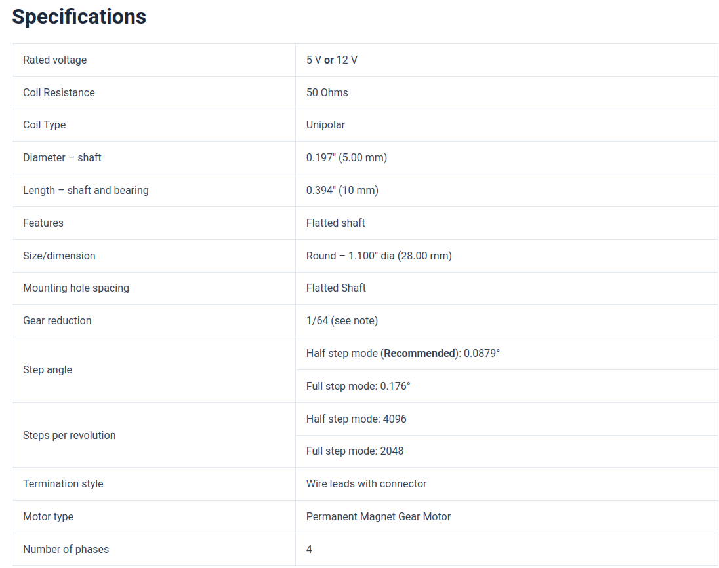
Datasheet for DESN2000 28BYJ-48
5.625 degree per half step
11.25 degree per full step
1/64 gear reduction
How many steps per full rotation?

Slide 29
Datasheet for DESN2000 28BYJ-48
5.625 degree per half step
11.25 degree per full step
1/64 gear reduction
How many steps per full rotation?
2048
  Let’s implement it in code

Slide 30
More reading
https://drufelcnc.com/?c=blog&p=Stepper_motors
https://cookierobotics.com/042/
https://www.haydonkerkpittman.com/learningzone/technicaldocuments/stepper-motor-theory

Slide 31
Other stuff
https://www.youtube.com/watch?v=QWaYaWujGp0
https://www.youtube.com/watch?v=OL7PFYeFPX8

