Slide 1
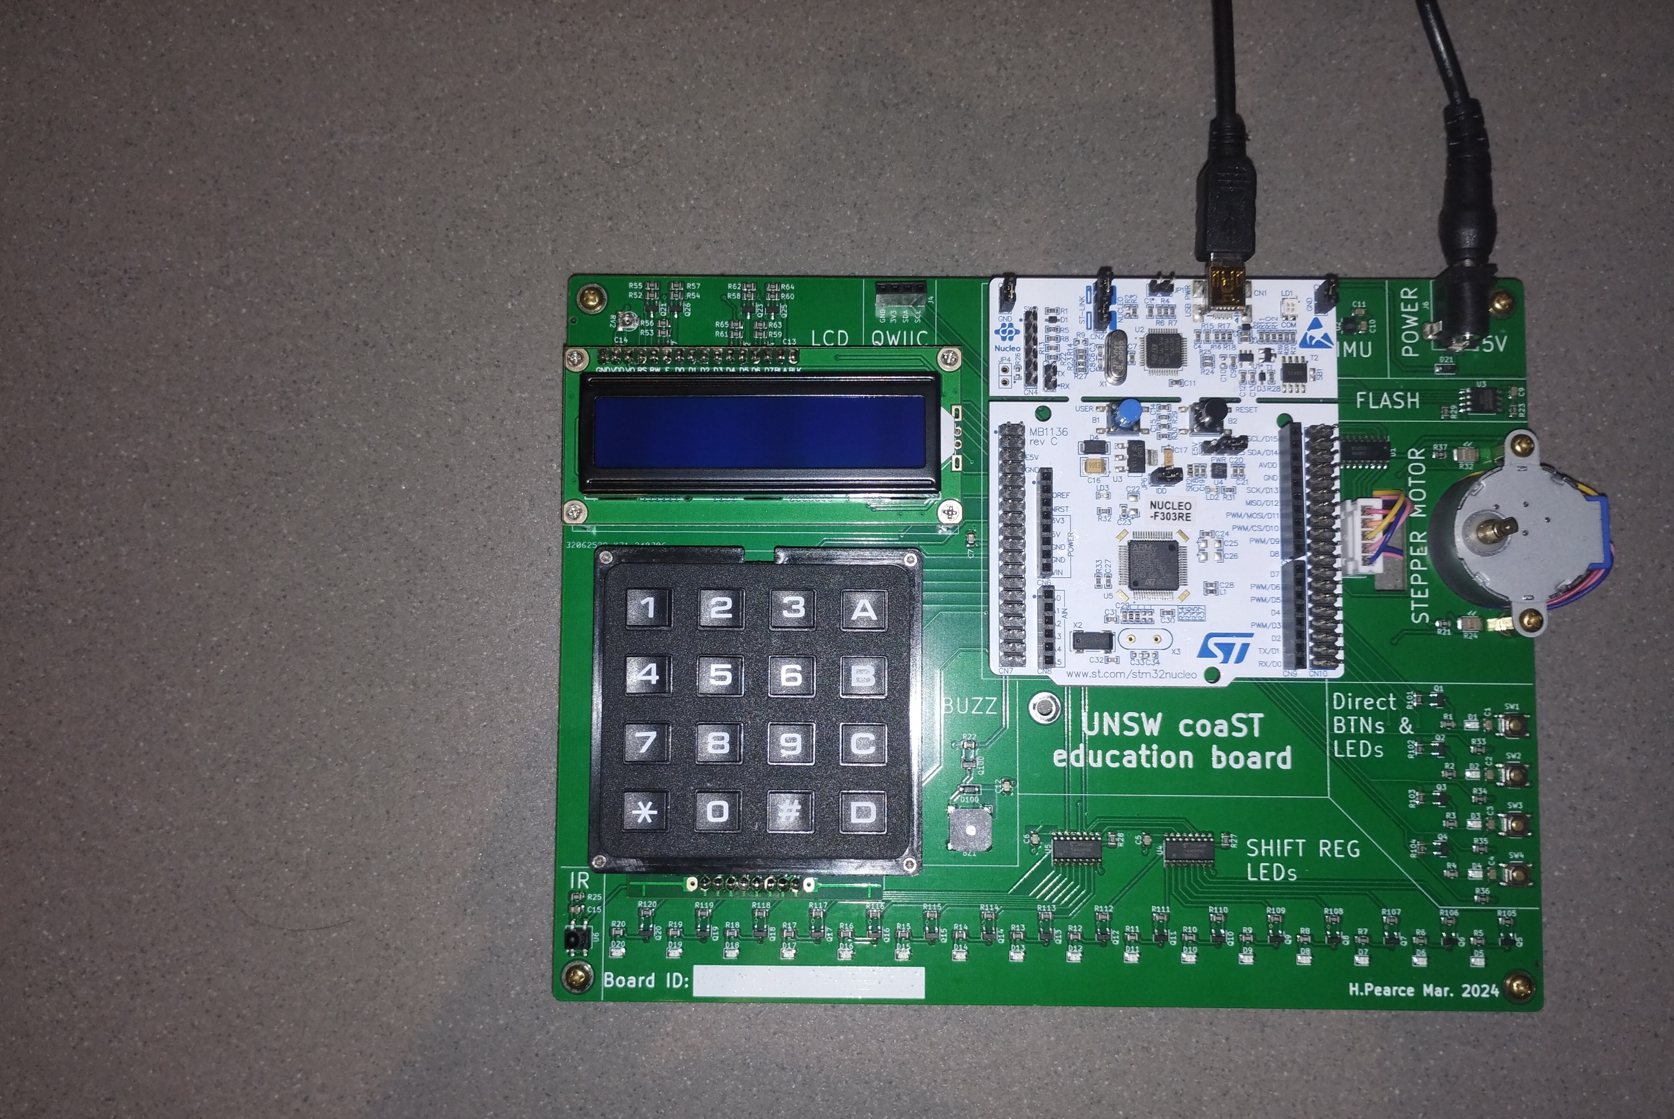
DESN2000
(Computer Engineering)
2025 T2
Stepper Motor
Hasindu Gamaarachchi
Notes:
put some pics

Slide 2
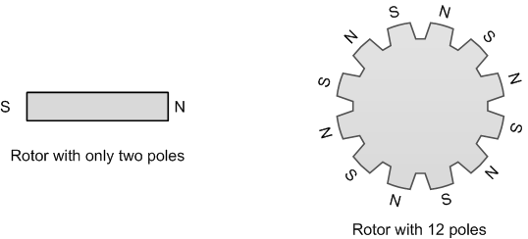
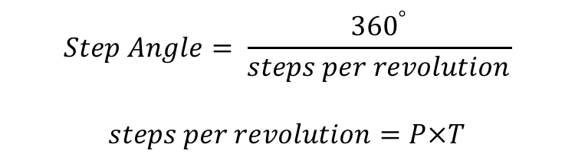
Step Angle
slide adapted from: Yifeng Zhu, Embedded Systems with ARM Cortex-M Microcontrollers in Assembly Language and C
$$Step Angle= \frac{{360}^{°}}{steps per revolution}$$
$$steps per revolution=P×T$$
where $P$ is the total number of phases on the stator, and $T$ is the total number permanent-magnetic poles available on the rotor.

Slide 3
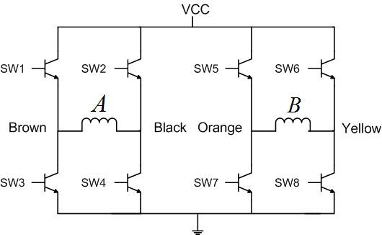
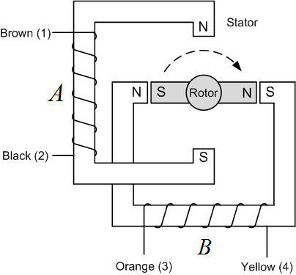
Bipolar Stepper Motor
slide adapted from: Yifeng Zhu, Embedded Systems with ARM Cortex-M Microcontrollers in Assembly Language and C

Slide 4
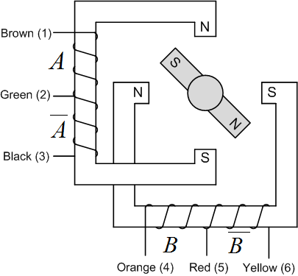
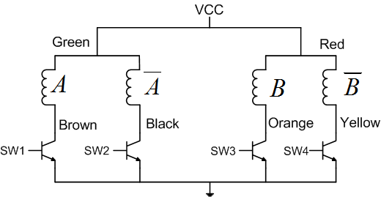
Unipolar Stepper Motor
slide adapted from: Yifeng Zhu, Embedded Systems with ARM Cortex-M Microcontrollers in Assembly Language and C

Slide 5
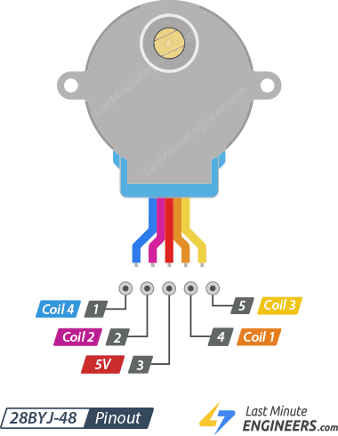
CoaST board: 28BYJ-48 Stepper Motor
CoaST board’s 28BYJ-48 stepper motor is unipolar

Slide 6
Unipolar Stepper Motor
slide adapted from: Yifeng Zhu, Embedded Systems with ARM Cortex-M Microcontrollers in Assembly Language and C
Coil B
Coil B
Coil D
Coil C
Coil A
Coil D
Coil C
Coil A

Slide 7
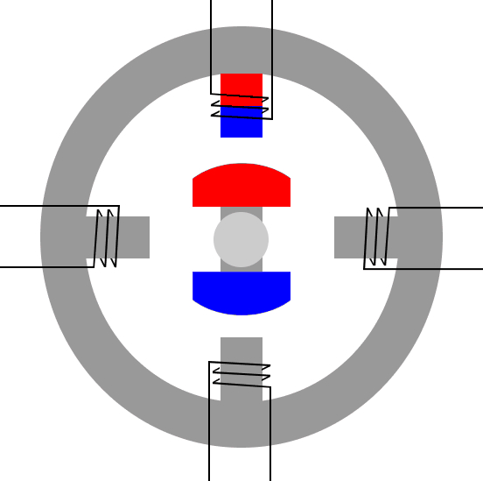
Wave Stepping
https://drufelcnc.com/?c=blog&p=Stepper_motors

Slide 8
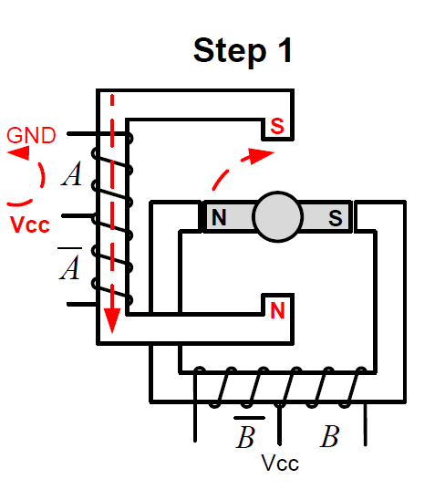
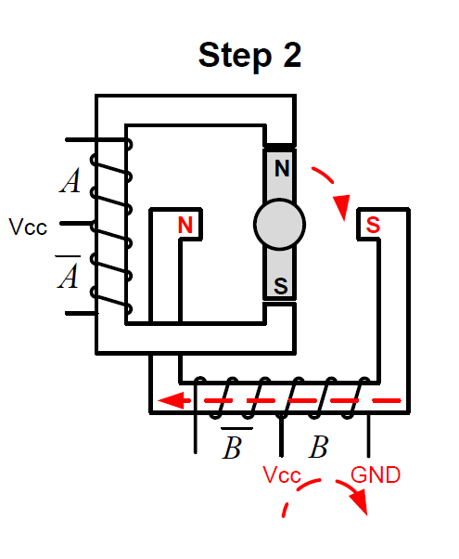
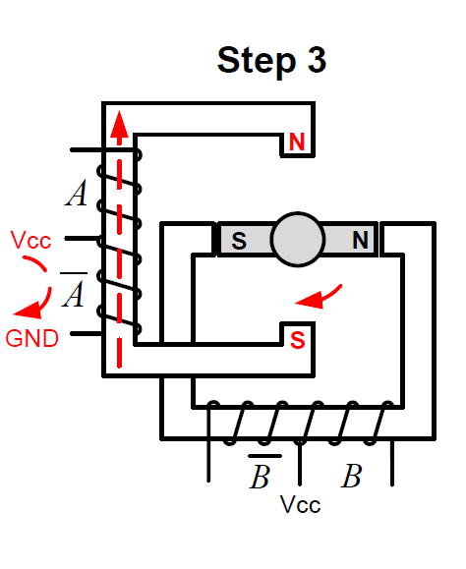
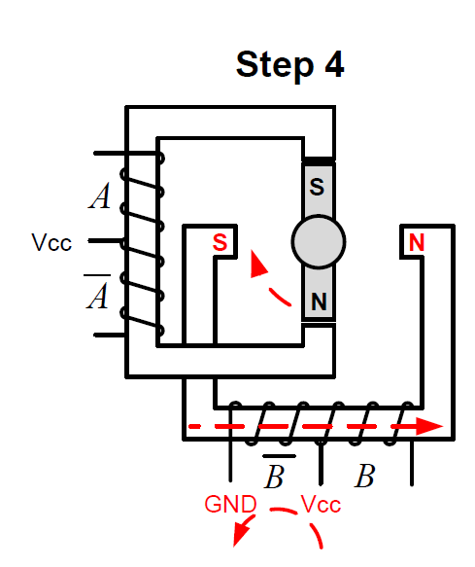
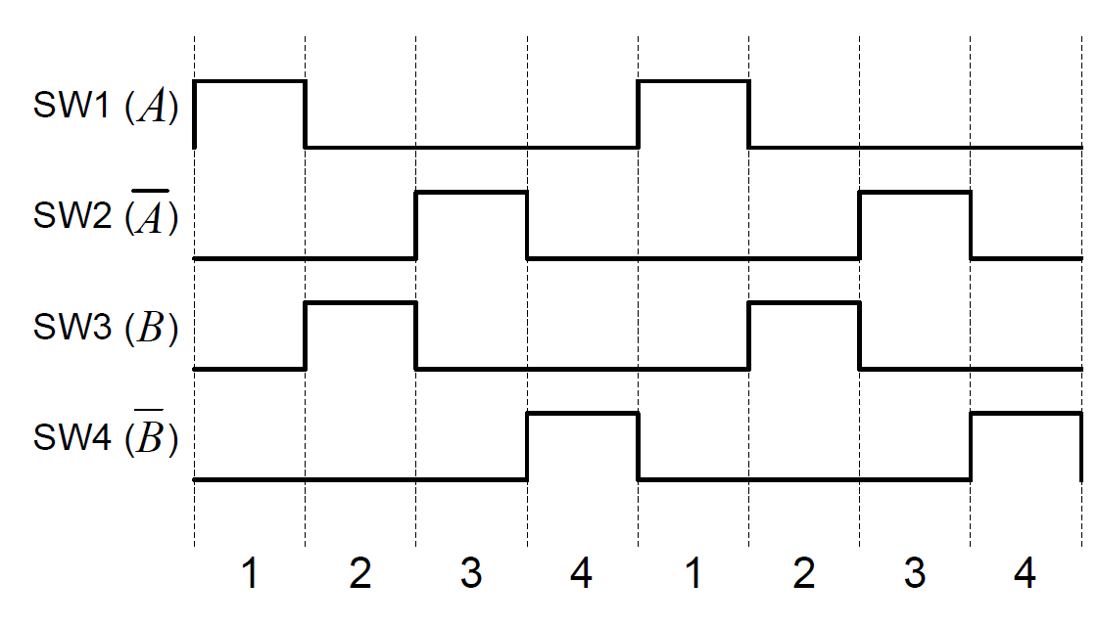
Wave Stepping
slide adapted from: Yifeng Zhu, Embedded Systems with ARM Cortex-M Microcontrollers in Assembly Language and C
B
B
B
B
D
D
D
D
C
A
C
A
C
A
C
A
COIL_B
COIL_D
COIL_A
COIL_C

Slide 9
Example
Write a program that infinitely rotate the motor using wave stepping method

Slide 10
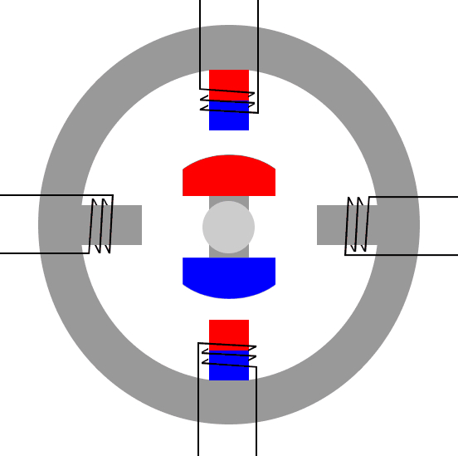
Full Stepping

Slide 11
Example
Write a program that infinitely rotate the motor using wave stepping method

Slide 12
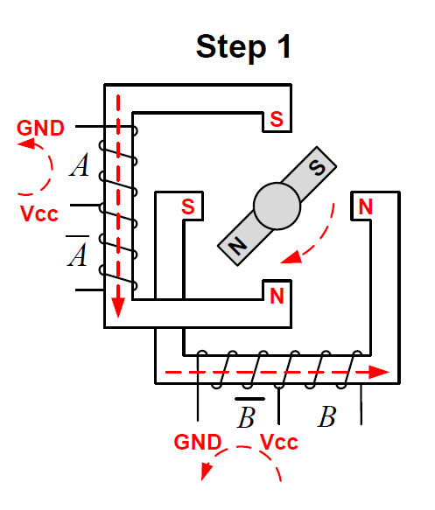
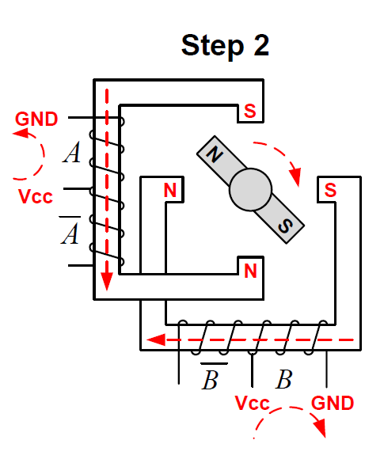
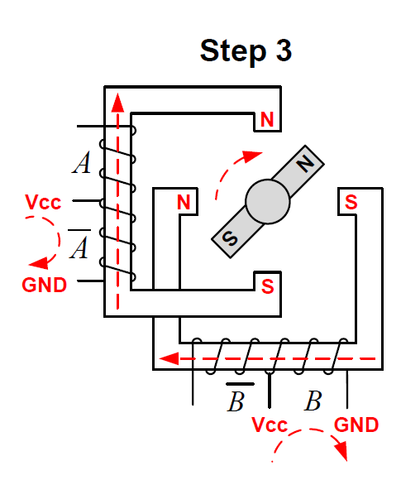
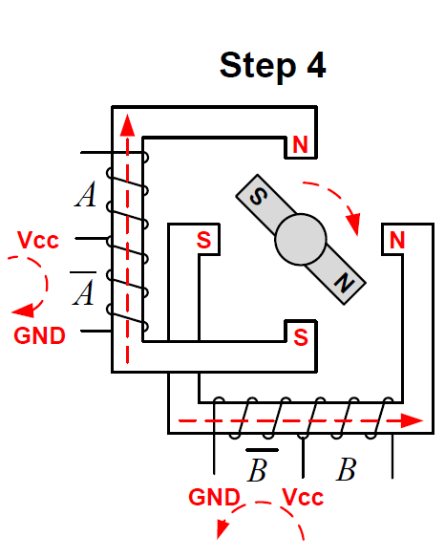
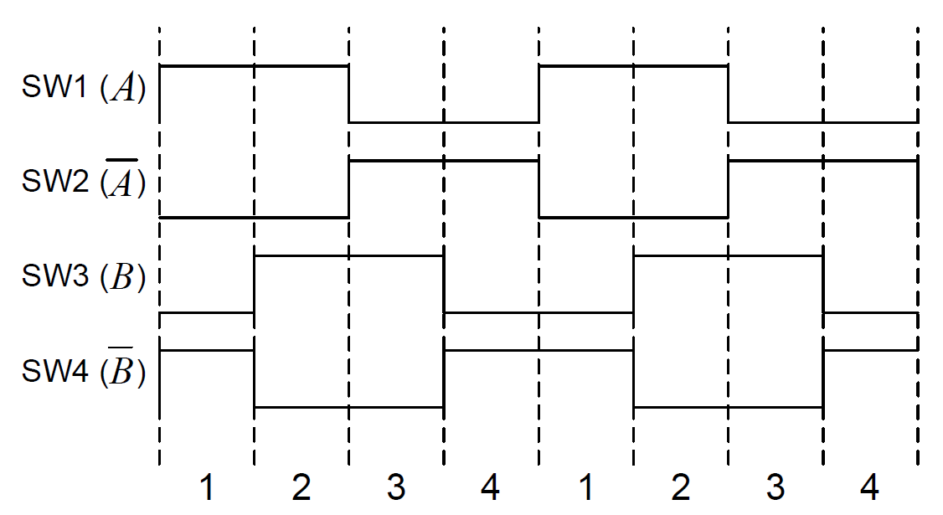
Full Stepping
slide adapted from: Yifeng Zhu, Embedded Systems with ARM Cortex-M Microcontrollers in Assembly Language and C
B
B
B
B
D
D
D
D
C
A
C
A
C
A
C
A
COIL_B
COIL_D
COIL_A
COIL_C

Slide 13
Example
Write a program that infinitely rotate the motor using full stepping method

Slide 14

Half Stepping

Slide 15
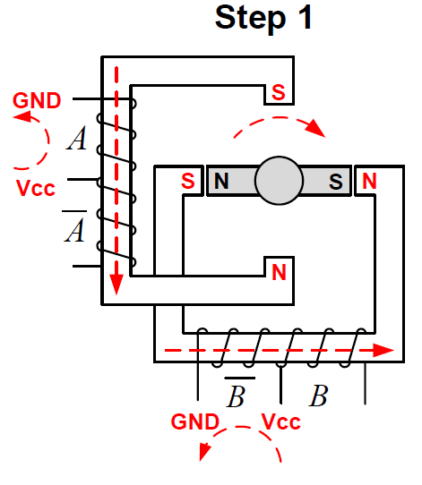
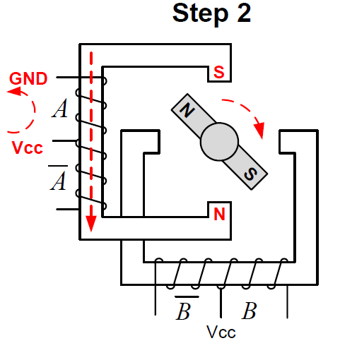
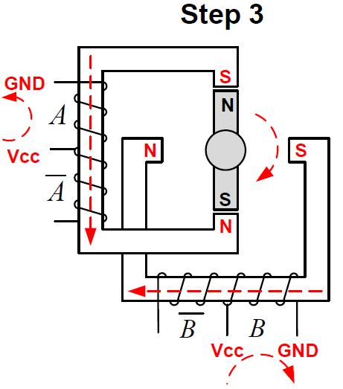
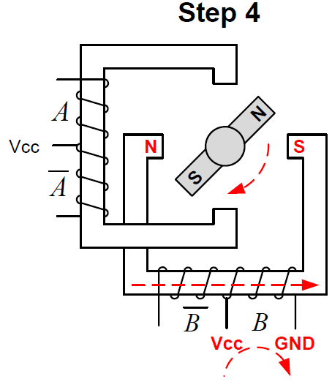
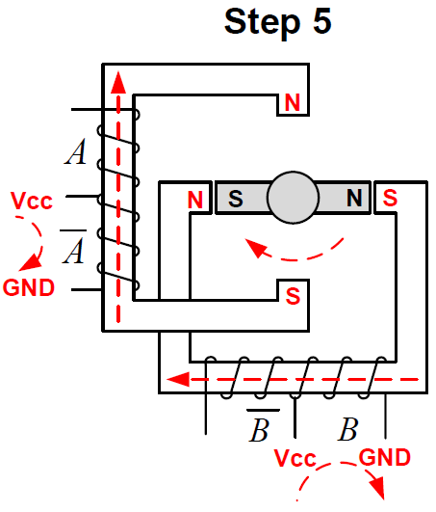
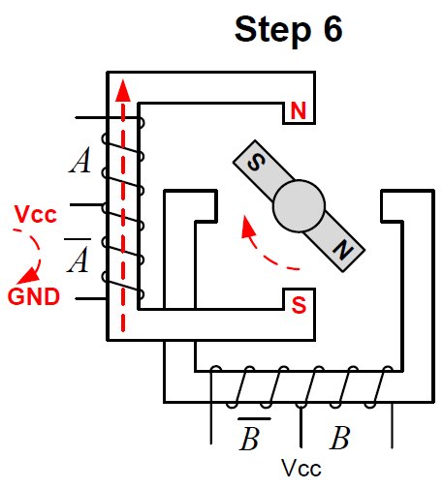
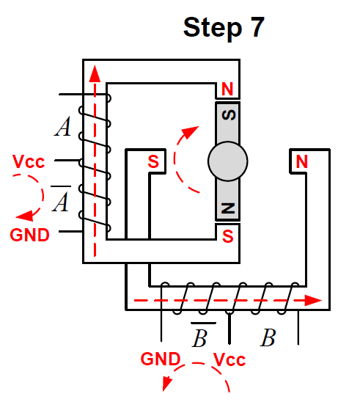
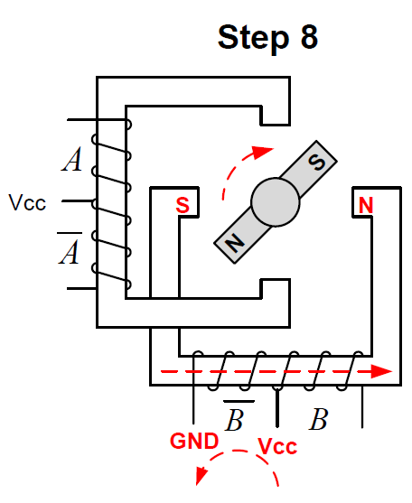
Half-stepping
slide adapted from: Yifeng Zhu, Embedded Systems with ARM Cortex-M Microcontrollers in Assembly Language and C
B
B
B
B
D
D
D
D
C
A
C
A
C
A
C
A
B
B
B
B
D
D
D
D
C
A
C
A
C
A
C
A

Slide 16
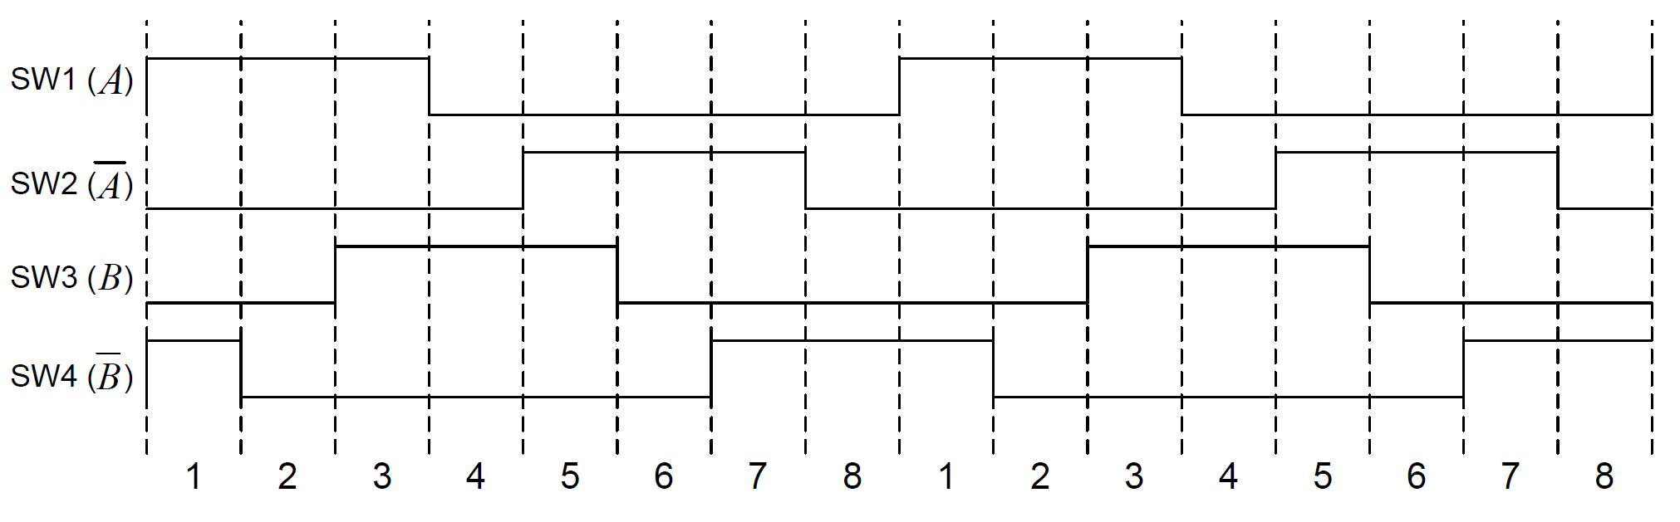
Half stepping
COIL_B
COIL_D
COIL_A
COIL_C

Slide 17
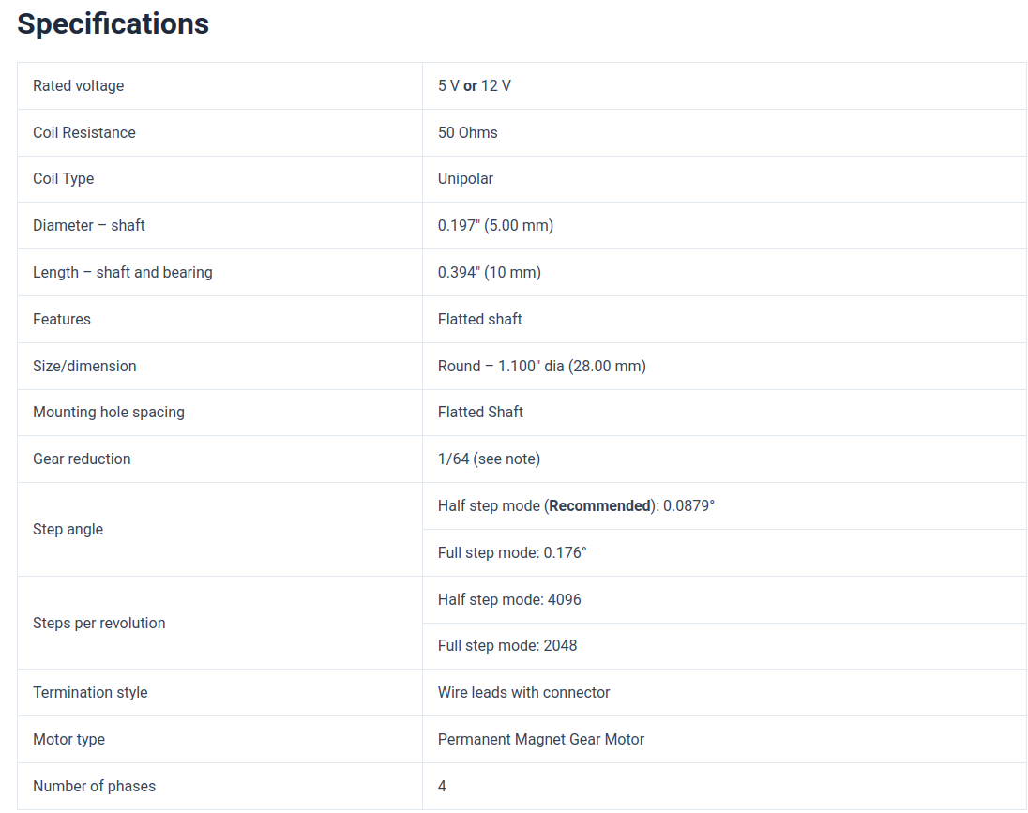
Datasheet for 28BYJ-48
5.625 degree per half step
11.25 degree per full step
1/64 gear reduction
How many steps per full rotation?
2048
  Let’s implement it in code

Slide 18
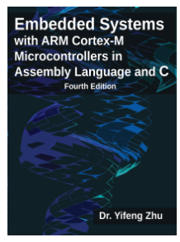
Learning Resources
“Embedded Systems with ARM Cortex-M Microcontrollers in Assembly Language and C (Fourth Edition)” – Yifeng Zhu
  General purpose I/O - chapter 15

